Slide 1
HAMWAN PACKET RADIO FOR THE 21ST CENTURY
Bryan Fields, W9CR w9cr@flscg.org

Slide 2
WHO AM I? HOW DID I GET HERE?
Bryan Fields, W9CR
Originally from Chicago/North West Indiana
Ran the first Wireless ISP in North West Indiana (2000)
Background in microwave network design
Carrier IP/Optical network Engineer
Relocated to St Petersburg, Florida in 2005
Sr. Consulting Engineer in IP/Optical Networks – Nokia
AMPRnet Technical Advisory Committee member

Slide 3
HAMWAN WHAT IS IT?
HamWAN is high performance multi-megabit networking over Amateur Radio
Network technology – Standards for an Internet connected wireless network
How to interconnect with ham users
How to route to the internet
Not all IP networks are HamWAN – Mesh/BBHN will never be capable of this.
An organization – HamWAN is a members organization
It’s responsible for standards and certifying affiliate networks
Founded in 2013 by a group of hams in Seattle, WA
Puget Sound Data Ring (PSDR) is the largest network of HamWAN coverage in the the US (and now Canada!)
Other networks can certify to be part of the HamWAN standard

Slide 4
WHY HAMWAN? CORE CONCEPTS
HamWAN is a linked network of cell sites
Sites have access radios for users and backbone radios to move data to other sites
Eliminates contention between access and backbone, a major problem in Broadband-Hamnet
All sites are routed allowing a secure and stable network with deterministic performance
HamWAN over the air clients must be Mikrotik NV2 protocol
A single proprietary standard, but a necessary evil. All run at 5.9 GHz in the exclusive part 97 space
Clients are intended to be nomadic, you can move a client radio from one site to another with out a reconfiguration.
HamWAN must be connected to the internet
Does not need to use AMPERNET IP space, however it’s free and a great resource.
IPv6 is encouraged and deployed in Tampa Bay HamWAN

Slide 5
WHY?
We need a backup to commercial Internet services.
The system cannot go down due to your cable modem going offline.
Protect our microwave bands!
Most of the good microwave bands are shared with Part 15.
That’s good, as most Part 15 wireless gear can be “tuned” into the Part 97 only parts of the bands. Cheap radios!
That’s bad, as everywhere has Part 15 radio, raising the noise floor for us, and making most of the band downright unusable. If the front end does not have a tight filter this makes the adjacent part 97 only channels harder to use. Good filters cost money, no cheap radios have them.
Part 15 operators (WISP’s, MSO’s and your neighbors) have trashed most of the Part 15 bands, and want more space. They are blissfully ignorant of how RF works.
“Hey these hams have space!” – They now are trying to take the exclusive bands from us.
5850-5925 is next, it’s even got a designator “U-NII-4”. The FCC is eying even 70cm and 23cm for commercial use.
10 GHz – Mimosa networks NPRM-11715. Backed by the WISPA industry association and a “former” ham. They want to take over all but 20 MHz of this band for commercial use at up to +55dBW (yes dBW, 316 kW) EIRP. I commented on this, did you?
3.3-3.5 GHz is next; there is a small allocation at 3.65-3.70 GHz* for WISP use. UK hams have lost most of the 23 & 9 cm bands

Slide 6
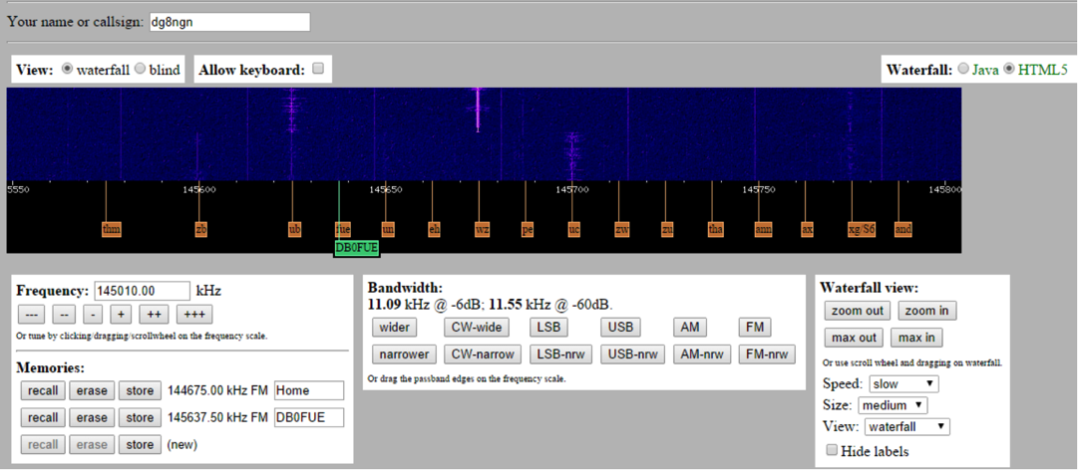
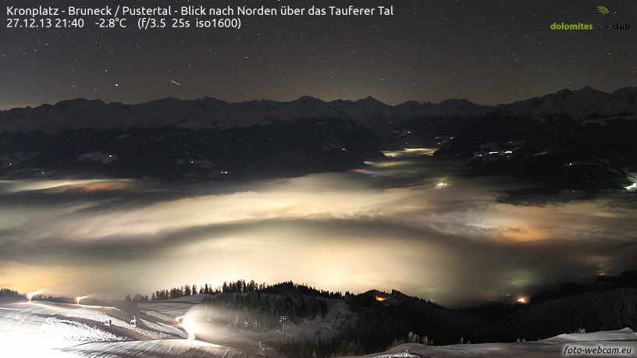
PRACTICAL APPLICATIONS
General Internet access for Hams*
Examples of some services that can run over IP networks
Repeater linking
All work over the Internet, but when your ISP goes down during an emergency, what good is the network?
Allstar link. My node is 40821.
ADSB Receiver linking – KJ4SHL has one by TPA
NXDN/P25/etc. is all IP based (multicast)
Wi-Fi based video cameras on site relay back to EOC!
Remote Radio control/WebSDR scanner/WebCams
http://www.foto-webcam.eu

Slide 7
INTRODUCTION TO NETWORKING THE INTERNET IN A NUTSHELL
IP Networking is basis of the Internet
Many smaller networks interconnected form the Internet
Anything that works over the Internet can be made to work over any IP network
Every device on the Internet needs a unique IP Address
Amateur radio has 44.0.0.0 to 44.255.255.255 “44/8” (16M IP’s)
This is managed by a non-profit and known as AMPRNET
IPv4 Space is hard to get in quantity now ($$$), lucky we have this resource with almost unlimited IP resources
IPv6 is encouraged!
All networks must know where to find destination IP stations
This is done via routing protocols, BGP between different networks externally and OSPF internally

Slide 8
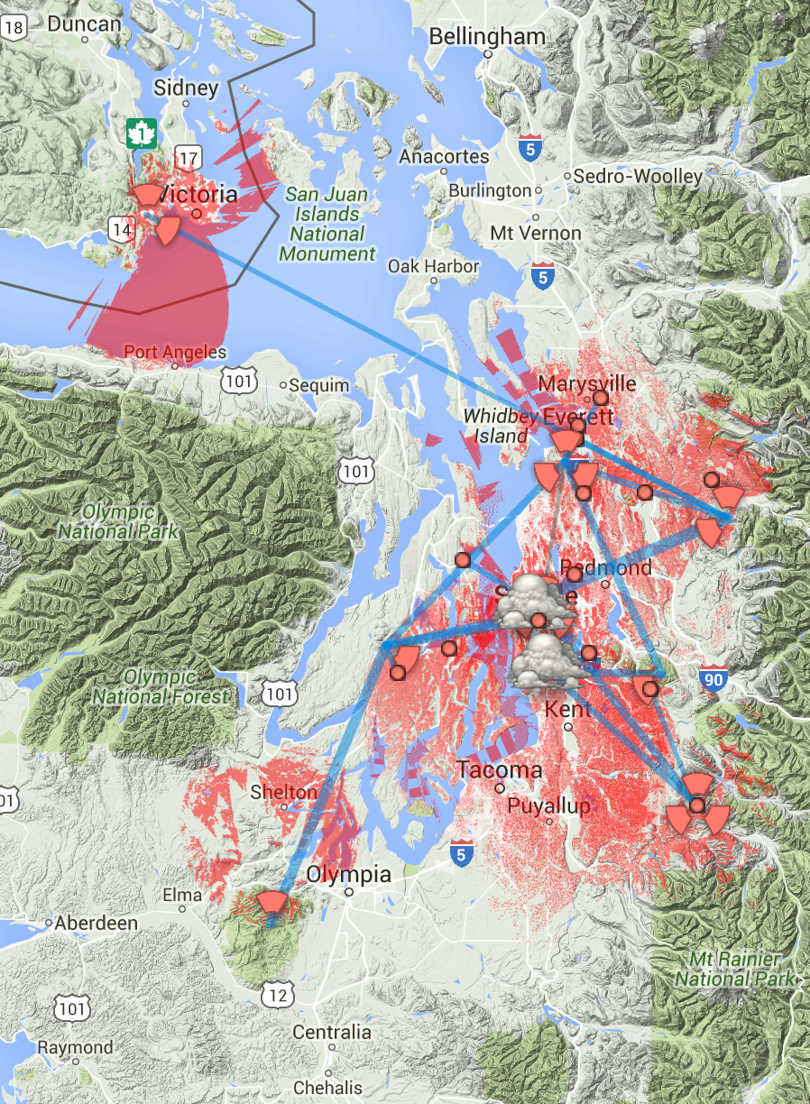
HAMWAN DEPLOYMENTS
Puget Sound Data Ring in Seattle area
Has about a dozen sites ➔
20 active users, with another 25-30 nodes for other hams registered
Certified
First cross border HamWAN network, a site in Victoria, BC came online a couple months ago. Over a 80 mile path for backhaul
Provides linking to a number of repeater sites and an EoC
All sites are on UPS protected power

Slide 9
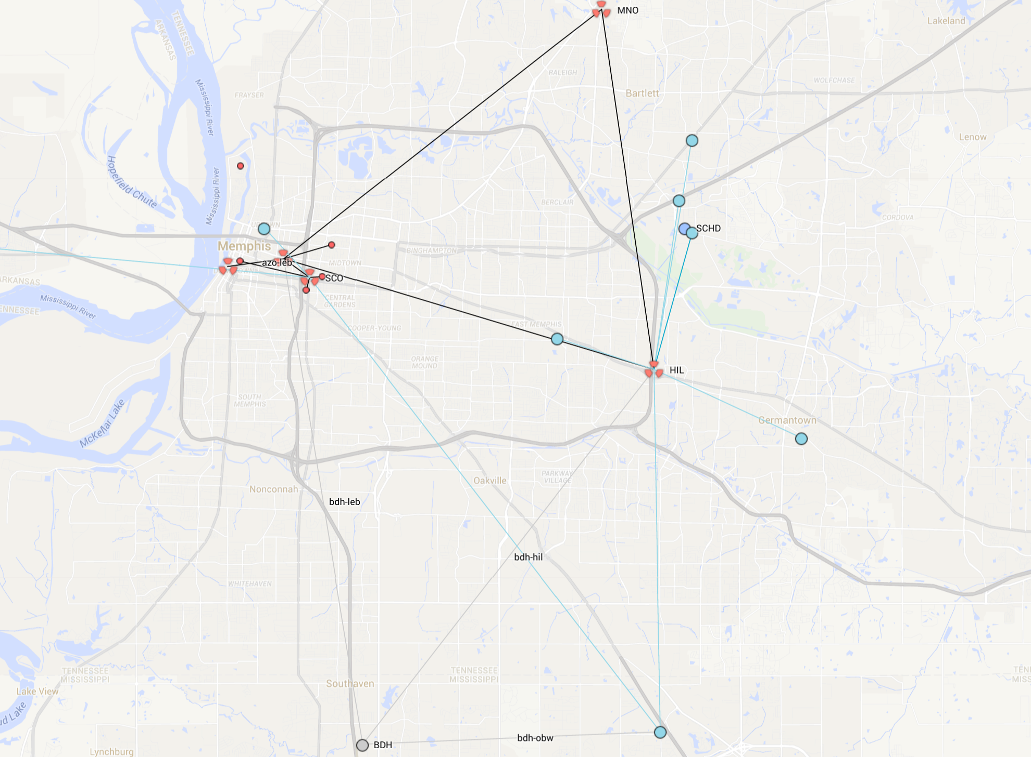
HAMWAN DEPLOYMENTS MEMPHIS METRO
Second certified network
Set out to cover the 10 county Memphis Metro region
Partnering with amateur radio clubs, technology and maker groups, and response agencies
Cell sites:
Midtown (SCO)
East Mem (HIL)
Methodist North (MNO)
Points of presence:
First Tenneessee (FTN)
LeBonheur (LEB)
Millington (MIL)
AutoZone (AZO)

Slide 10
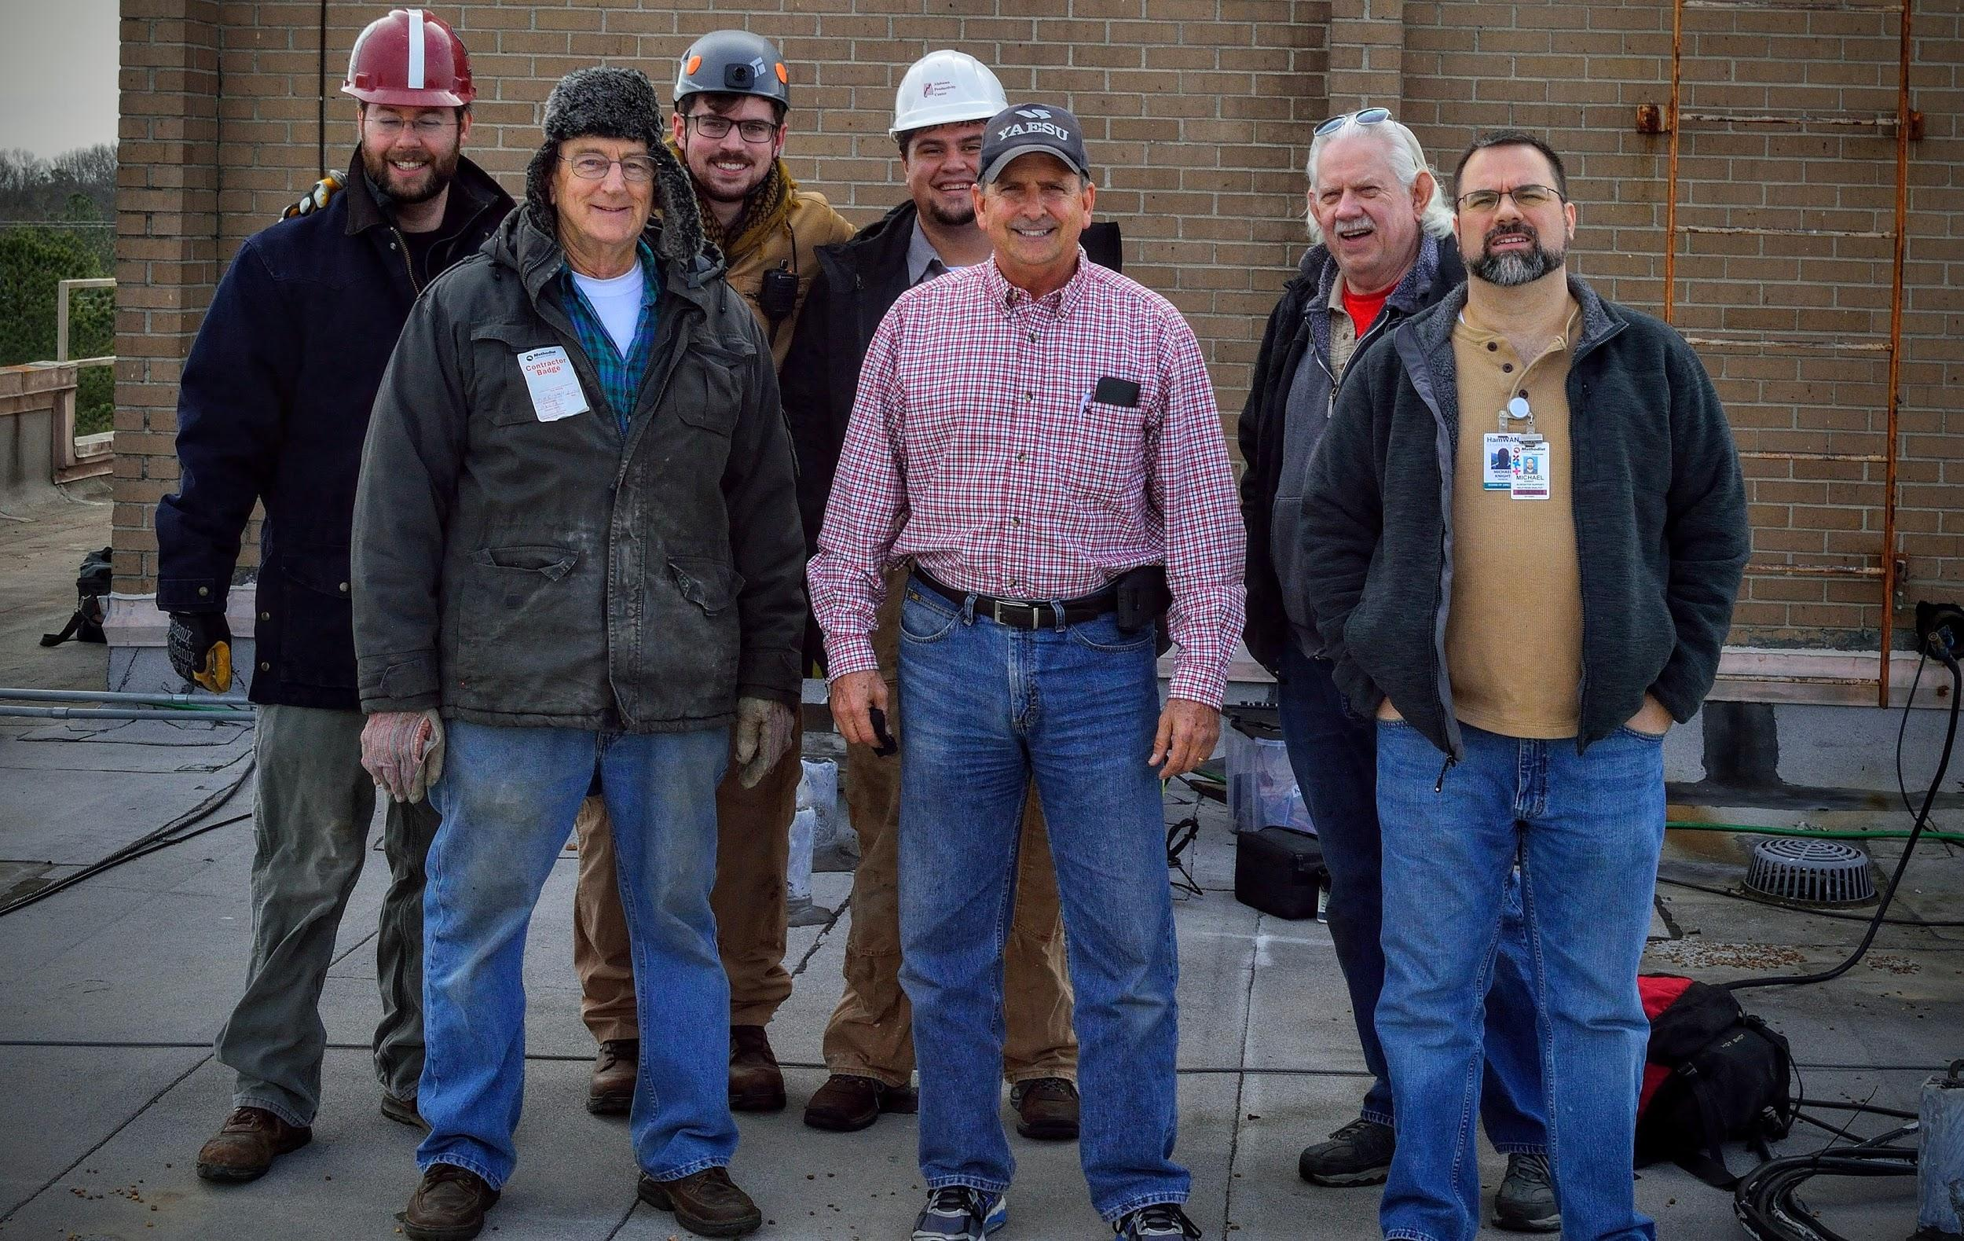
HAMWAN DEPLOYMENTS MEMPHIS METRO
Network Services – Running today with redundancy + resiliency:
Flight tracker (on flightradar24.com)
IP Cameras (for weather, traffic, site equipment)
Weather stations (on weather underground)
VoIP and Video Conferencing
Monitoring and logging
Streaming of scanners and receivers
Provide network connectivity for other club’s D-Star and Allstar repeaters

Slide 11
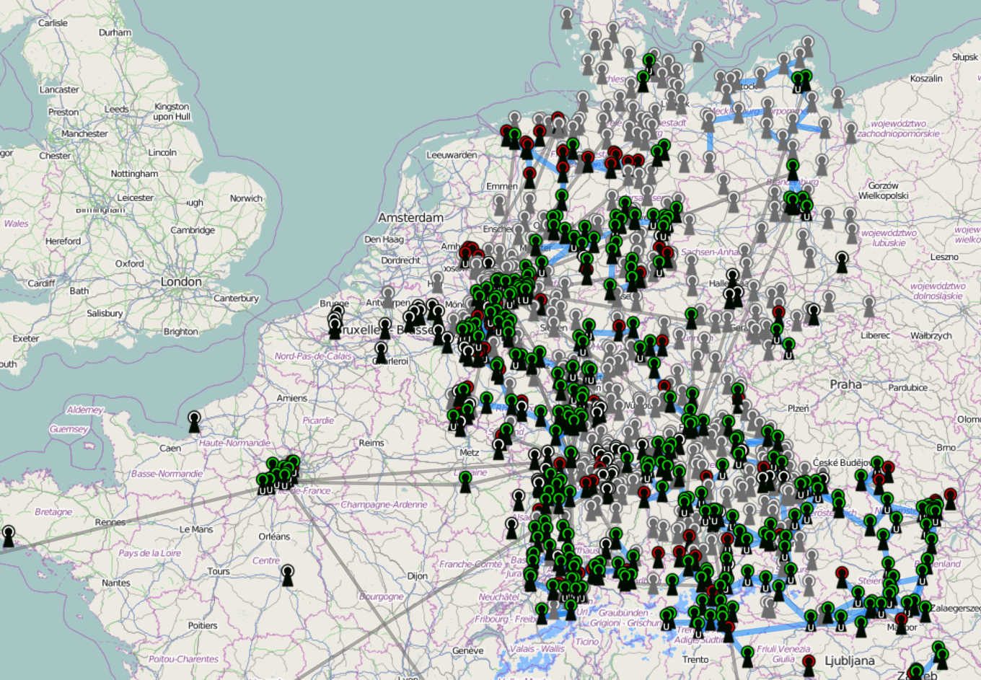
WHAT OTHER GROUPS ARE DOING EUROPEAN HAMNET
European HamNET - http://hamnetdb.net
Covers most of central Europe including: Germany, The Netherlands, Switzerland, Belgium, North Italy, Czech Republic
About 4k nodes/users. It’s by far the largest deployment
Unfortunately it uses the IP-IP legacy 44net IP transport, but is moving away from that to BGP. This means everything must go via UCSD gateway to reach the internet.
Jann, DG8NGN has done an amazing job!

Slide 12
HAMWAN DEPLOYMENTS TAMPA BAY
Deployed Tampa Hub April 2016
IPv6 Enabled!
Core building site has been secured
Florida is not blessed with mountain tops or terrain
Fiber had to be fusion spliced for this
5.9 GHz Sectors are in place
Started in January 2016 after MOU with site manager
Proposed coverage based on 30 dBi client
Also support three analog repeaters
224.280, 443.525, 927.050
Organized under Florida Simulcast Group, Inc. a 501(c)3 non-profit

Slide 13
HAMWAN DEPLOYMENTS St Petersburg
Deployed December 2016
Links back to Tampa at 3.4 GHz
140 Mbit/s Link -65 dBm Signal with 24 dBi Dish
Proposed coverage based on 30 dBi client
Tested to link up in Sarasota at -85 dBm
90’ up on a building at 30 Miles
Supports a couple repeaters
KA9RIX has his hub linked on it from Madeira beach.
North county coverage could be better

Slide 14
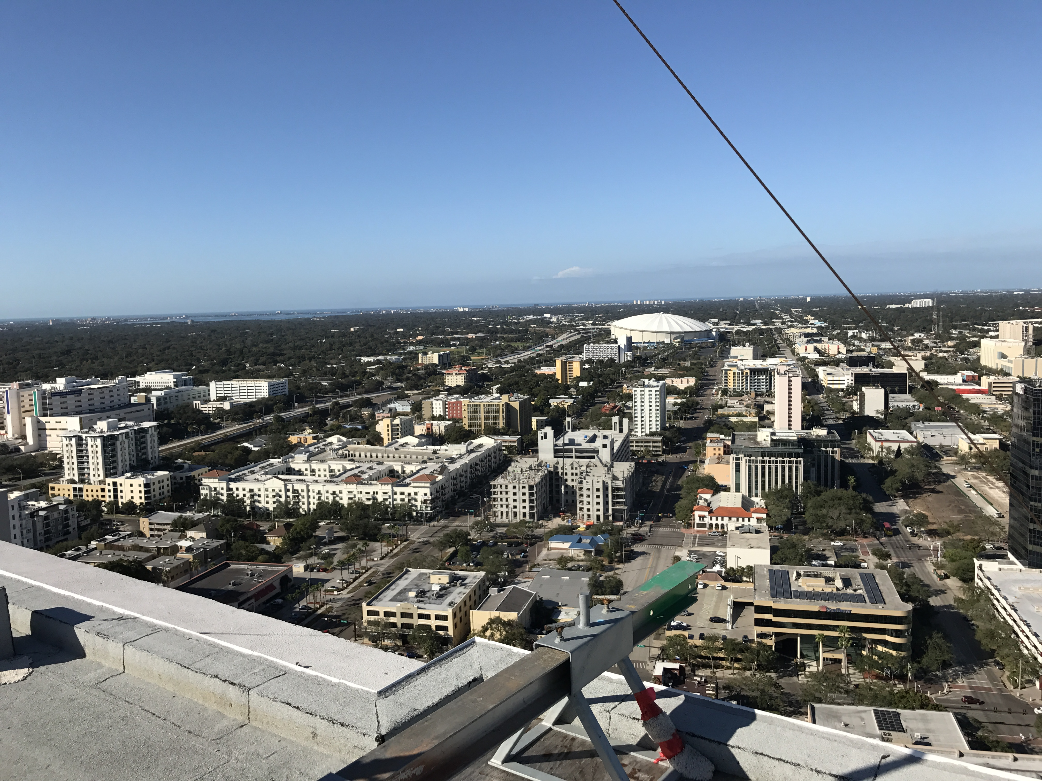
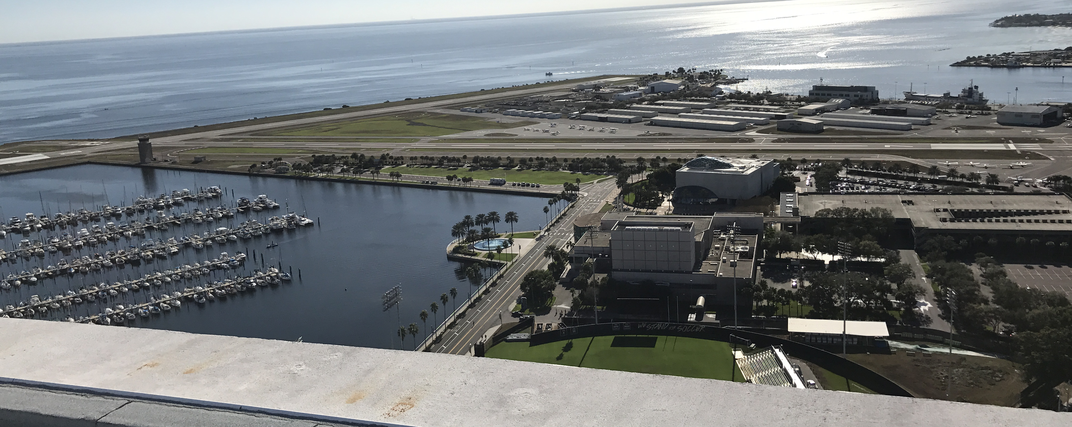
HAMWAN DEPLOYMENTS St Petersburg

Slide 15
HAMWAN DEPLOYMENTS St Petersburg - Tampa
Combined coverage of Network is excellent
We fill in several nulls from Tampa
Looking to the future
Expansion to Sarasota
This is planned for 2017 at 280’ in downtown
Will enable a full ring redundant backbone
Sarasota to Tampa shot is a bit long at 42 miles.
Can we pickup a site on the East side of the Bay?

Slide 16
NETWORK ARCHITECTURE ACCESS SITES, BACKBONE AND INTERCONNECT
Major parts of the network
An access site is basically a rooftop user facing access points (AP’s) are on.
AP’s are in the 5.9 GHz band. Provide end user access, must be Mikrotik to be HamWAN
Backbone links at 9cm, or unlicensed bands, anything that is IP transport will work
Router – All radios (AP’s and backbone) are connected to a router (JNPR EX 4200)
An access site is ideally co-located with a conventional/digital repeater for linking voice over the network
As with any site this should be on generator or emergency back up power.
Notes:
AP’s are in the 5.9 GHz band and have 120° sector antennas on them. Other hams in range have the Client radio pointed on it. Multiple people can send and receive data on this at the same time.
Access sites need a way to get data off the site and to the internet, so there is one or preferably more, back bone links from the site to other sites. These are high bandwidth 9 cm band data radios (130 mbit/s+). With more than one radio we can have automatic failover between these links in the event one fails or must be removed for repair.
All radios (AP’s and backbone) are connected to a router. This router has a view of the entire network and knows how to get packets where they need to go. In the event a path fails this is the device that figures out a new path to push the packets out over.
An access site is ideally co-located with a conventional/digital repeater for linking voice over the network
As with any site this should be on generator or emergency back up power.

Slide 17
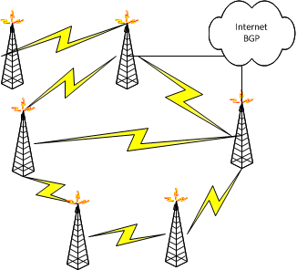
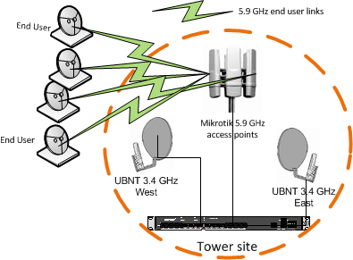
NETWORK ARCHITECTURE ACCESS SITES, BACKBONE AND INTERCONNECT
Access Point Site
Network Overview
Notes:
AP’s are in the 5.9 GHz band and have 120° sector antennas on them. Other hams in range have the Client radio pointed on it. Multiple people can send and receive data on this at the same time.
Access sites need a way to get data off the site and to the internet, so there is one or preferably more, back bone links from the site to other sites. These are high bandwidth 9 cm band data radios (130 mbit/s+). With more than one radio we can have automatic failover between these links in the event one fails or must be removed for repair.
All radios (AP’s and backbone) are connected to a router. This router has a view of the entire network and knows how to get packets where they need to go. In the event a path fails this is the device that figures out a new path to push the packets out over.
An access site is ideally co-located with a conventional/digital repeater for linking voice over the network
As with any site this should be on generator or emergency back up power.

Slide 18
NETWORK ARCHITECTURE ACCESS SITES, BACKBONE AND INTERCONNECT
Network Backbone & Interconnect
The backbone consists of the interconnect between all sites.
These can be almost any radio or frequency band, so long as they support the bandwidth needs of the sites flowing over it.
In TB HamWAN we use the 9cm band for many good reasons
No chance of interference between ISM/U-NII users and hams, the only users of this band are hams and the government.
Slightly lower path attenuation and larger Fresnel zones means easier links.
Keeps our backbone out of the 5cm Band where we have our AP’s
One disadvantage is antennas tend to be about 40% larger than an equivalent gain antenna on 5cm
Interconnect Routers
These are the connection of the RF backbone into the internet.
These sites require only back bone radio and a higher performance border router.

Slide 19
WHAT DOES THIS LOOK LIKE? RADIOS, ROUTERS, ETC.
Two major vendors of product
MikroTik
Linux based with a bunch of propriety stuff, good support for SBC/router boards and Wi-Fi cards.
Great for “roll your own”
I tend to favor this for ham radio, with the exception of the UBNT gear for PtP 9cm band links
Ubiquiti - UBNT
Has their own OS (2 actually). Both Linux based with add-ons same as MikroTik.
Makes some good all in one radios, not known for their routing.
No longer ham friendly as they will not give out the code to unlock the 5.9 GHz band or support this anymore.
Other vendors
DBII - cool mini-pci radio cards, good support with MikroTik

Slide 20
BASE STATION
Sector Antennas
UBNT 19dBi Sectors and Shields
5.9 GHz
Back bone links
9cm (3.4GHz) Band
24 dBi Dish antennas
MiMo, uses H and V pol simultaneously
HamWAN has a site BoM on the wiki
Typical 3 sector site ~2k USD in hardware

Slide 21
30 DBI CLIENT MIKROTIK 5.9GHZ
MikroTik RB912 MiMO 1.3W Station
About $70
Typically with shielded box
2’ Dual Polarity UBNT Dish
30 dBi Gain – Radio mounts to dish
30+ ft. mounting height recommended
~$200
Highest performance
What all coverage maps are modeled to

Slide 22
24 DBI CLIENT MIKROTIK 5.9GHZ
MikroTik Mikrotik DynaDish 5
About $150 on Amazon, $180 on prime
Includes radio, dish, and POE
No connections needed, radio in part of antenna.
Simple to install
30+ ft. mounting height recommended
Moderate performance
Signal will be -5 dB from coverage maps.

Slide 23
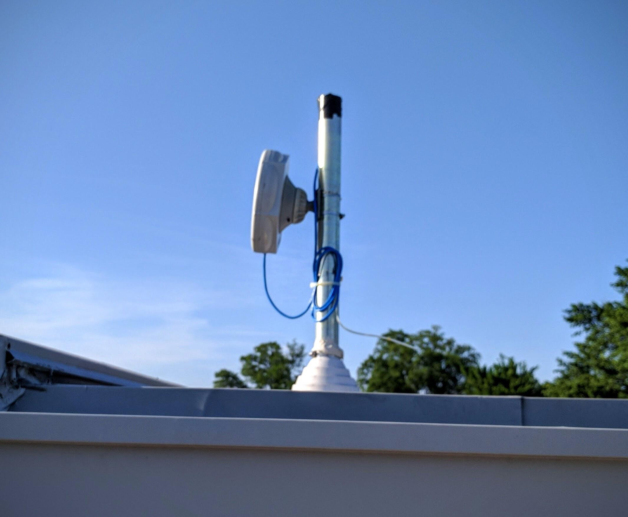
TYPICAL INSTALL

Slide 24
MICROWAVE BAND OVERVIEW
5 GHz Bands
Lots of overlap for Hams, only a 50 MHZ sliver of our band is truly “free”
Most commercial operators don’t “play nice”

Slide 25
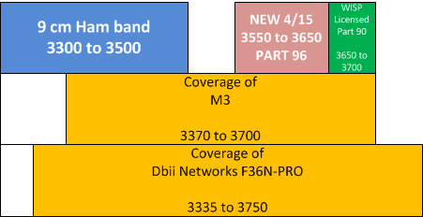
MICROWAVE BAND OVER VIEW CONTINUED
3 GHz Band – 9 cm
No Other users… Yet.
OFCOM (UK FCC) has eliminated most of the 9cm band from UK hams for broadband
Part 96 new allocation at 3550 to 3650.
Ideal for inter-site links

Slide 26
PROPAGATION AND PATH ANALYSIS WILL IT WORK ALL THE TIME? AT ALL?
Microwave is basically “Line-of-Sight”
There are some links that don’t need it, but at much reduced capacity.
Radio will modulate down (FM to SSB to CW) in the event of signal loss/fade, but capacity (mbit/s) goes down
This may be fine for temporary/field ops, but not for a production network
We need to ensure availability of the backbone at all times.
This means shorter links typically are better (15 miles at most) even though 30 miles will work.
The atmosphere is not a perfect medium it can delay/bend/distort signals during certain weather. Over water is fun!
Need what’s called “fade margin”, extra signal above the minimum.

Slide 27
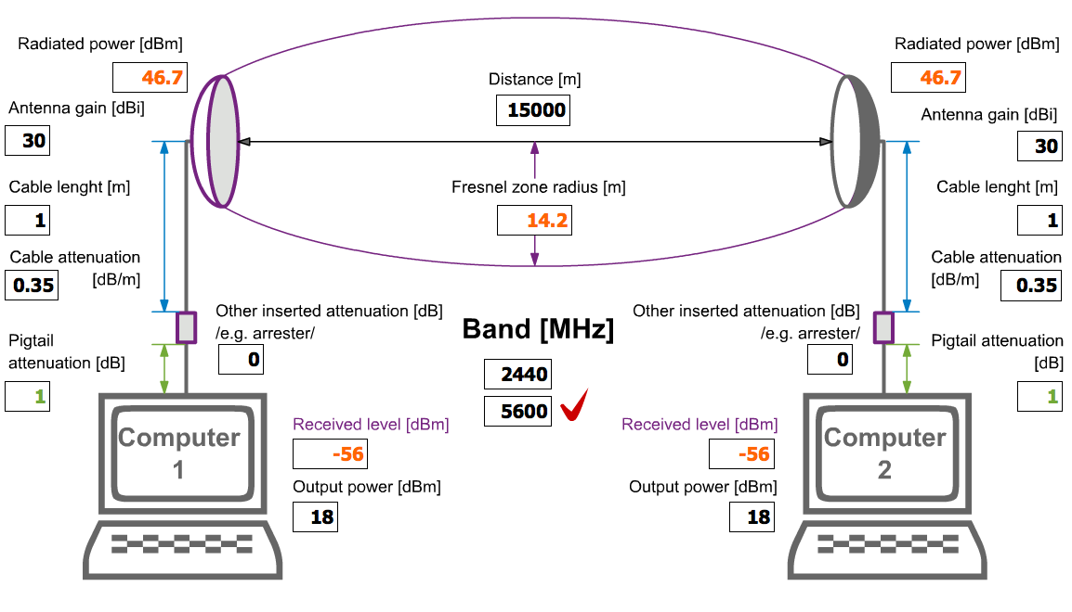
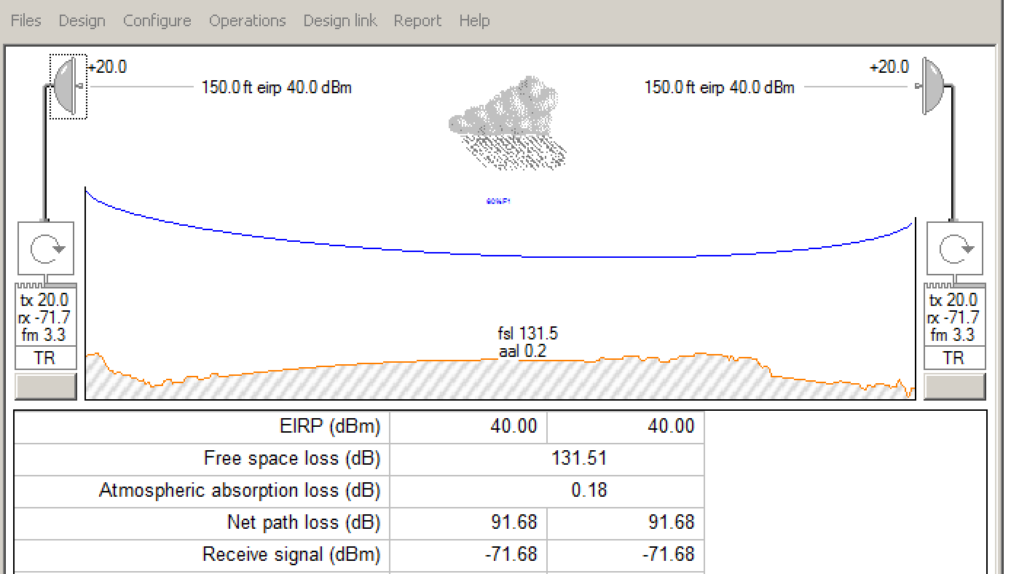
CALCULATING PATHLOSS
Free (beer) software online
Radio Mobile
WiFi Calc
Non-Free Software
Pathloss 5.0
Industry standard for microwave path prediction
Awesome program, I own it.
Models reflection/diffraction/multipath/rain
About $7k

Slide 28
MODULATIONS AND PROTOCOLS QAM VS. CHANNEL SIZE VS. THROUGHPUT VS. SIGNAL RATE VS. AIRTIME
How much throughput can my link support? It’s a 300 mbit/s radio!
Not as much as the box says. Many things influence this
QAM – Quadrature Amplitude Modulation level AKA MCS index
Channel size – Bigger channels with higher mod level means more throughput
Airtime – The amount of time the radio spends transmitting
Network Protocol – Wi-Fi vs. proprietary
Distance – Long distance links can affect performance
MiMo – Multiple input Multiple output.
Notes:
QAM – Quadrature Amplitude Modulation level AKA MCS index – the type of signaling used Higher modulations pack more data in a given bandwidth. The amount of signal required also goes when you increases this.
Channel size – Bigger channels with higher mod level means more throughput, but you run out of spectrum for 40 MHz channels fast! Reducing channel size will reduce throughput but lower the signal required.
Airtime – The amount of time the radio spends transmitting. TDD radio TX and RX on the same channel. They can’t TX at the same time and this TX/RX turn around takes time (30-40 ns). Higher data rates move more data in a given TX/RX cycle and increase throughput.
Network Protocol – Both MikroTik and UBNT have their own Over the Air (OTA) protocols which enable greater performance than standard Wi-Fi. They are not compatible with each other…
Distance – Long distance links can affect performance as bits of data are literally in the air. This is more of an issue on an AP serving many clients than a PtP link.
MiMo – Multiple input Multiple output. This actually transmits H&V pol at the same time on the same channel. It takes advantage of the resulting interference and delays to encode much more data in the same channel.

Slide 29
ROUTERS ROUGHT-ERS NOT ROOT-ERS
Routers are the repeater controllers of the network.
Routers know what the entire network looks like at any given time.
They know this through the use of Routing Protocols.
TB HamWAN uses IS-IS
These are what provide the resiliency to our network.
If a link dies in the back bone, they will “route” around it. Users would never know!
TB HamWAN has standeridside on the Juniper EX4200
Cheap ($300 on eBay) and many donated ones from members
10g performance and mature OS
Easy to manage
Notes:
Routers know what the entire network looks like at any given time.
They know this through the use of Routing Protocols.
Simply a mathematical model of the network.
There are many protocols, but OSPF is the most popular
BGP is used to interconnect networks to the internet
These are what provide the resiliency to our network.
If a link dies in the back bone, they will “route” around it. Users would never know!
Many different types, major manufacturers include
Alcatel-Lucent, Cisco, Juniper, Brocade.
PC’s running Linux can route packets. MikroTik is a cheap rugged version of this. Software routers have their limits though.

Slide 30
LEGAL ISSUES IT’S MORE FUN TO POINT OUT POTENTIAL PART 97 VIOLATIONS THAN DO SOMETHING!
Part 97 puts some restrictions on our communications as hams
Legally the control operator is responsible for every packet of data his node X-mits
Inbound traffic from the internet (ping/traceroute/etc.) can cause transmissions of packets.
No encryption
Wi-Fi has link level crypto as an option, obviously this is not legal
This presents some interesting issues regarding the use of our network for welfare type traffic which may be under HIPPA. Many times this uses session level encryption (SSL). Is this legal?
How to ID a link? HamWAN solves this via the modem name
All stations must ID. SSID would be one callsign. Encoded ICMP/Locally administered MAC’s encoded with callsign work too
Only licensed amateur radio operators can connect.
This proposed network should be for Amateur Radio use only. No public Wi-Fi, etc. EOC internet access during an emergency or other temporary use should be fine IMO.

Slide 31
INTERNET INTERCONNECT TAMPA ONLY FOR NOW
Edge sites should are where the network connects to the public Internet
These sites can be at a data center or even via a VPN
The routers will announce the IP address used on the network to the internet
This design allows multiple internet connections at different parts of the network
A “normal” cable modem/DSL connection will not work for this
These are designed to serve up a single IP address for end user use.
BGP – Border Gateway Protocol is the routing protocol used for this.
It’s policy based rather than cost based.

Slide 32
IDEAL SITE LOCATIONS HEIGHT IS MIGHT (NOT ALWAYS)
Centrally located so many hams can see it from their homes/other sites
Lower sites (150’) are fine.
Easy access (outside of normal 9-5 hours)
Should be able to be on the back up power
All tall buildings have backup generators for elevators, at most a UPS would be needed for a few minutes
A good ground must be available
Ability to make changes and install multiple antennas
Everything installed must be to commercial standards. (R56)
Notes:
Backup Power
All tall buildings have backup generators for elevators, at most a UPS would be needed for a few minutes
A good ground must be available
Multiple antennas
Backhaul, sector, and others
Ideal to colo repeaters at some of these sites too.

Slide 33
CONCLUSION WHO’S IN?
We need interest, even if you’re not a networking person
Every region in the US needs a HamWAN network
TB HamWAN is designed for growth!
Get a client online for under $200!
We can interlink entire states
Think of the public service aspects of this, multi-megabit file transfers and other applications linking EOC’s
Typically a small group of dedicated hams involved.
We can actually bring younger hams into the project and have them learn.
Lots of interest from High School/college networking classes
Notes:
Limited scope
Build and operate a wireless network supporting public service. No intention to be trained in FEMA type classes

Slide 34
ADDITIONAL RESOURCES
Florida Simulcast Group – http://flscg.org
Small group of techie hams in the St Petersburg/Tampa region
Florida Non-Profit, 501(c)3 federal charitable status.
My YouTube channel - https://www.youtube.com/user/gulfcoastequity/videos
HamWAN - http://www.hamwan.org
#hamwan and #44net on irc.freenode.net.
Me, W9CR is DarkHelmet, stop by and say hi
44net email list - http://www.ampr.org/pubs.html
Memphis Metro HamWAN – http://memhamwan.org/
My wiki, mostly radio and hacking stuff – http://wiki.w9cr.net/

Slide 35
THANK YOU

Slide 36
Backup slides

Slide 37
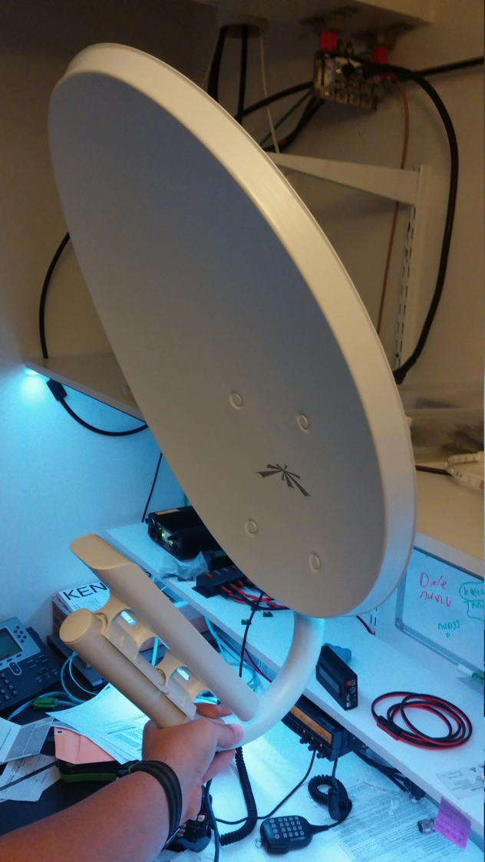
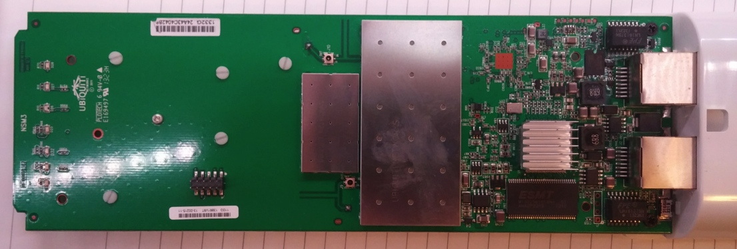
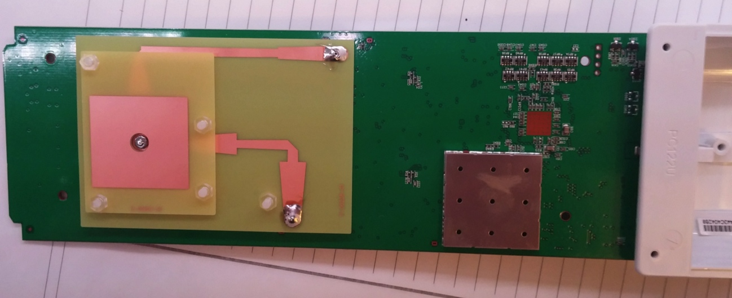
UBNT NANOSTATION M3 9CM BAND

Slide 38
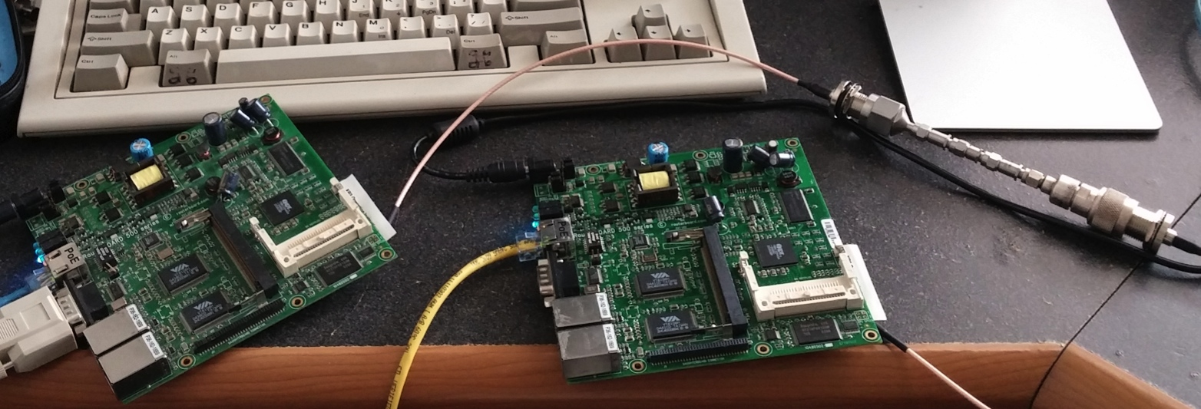
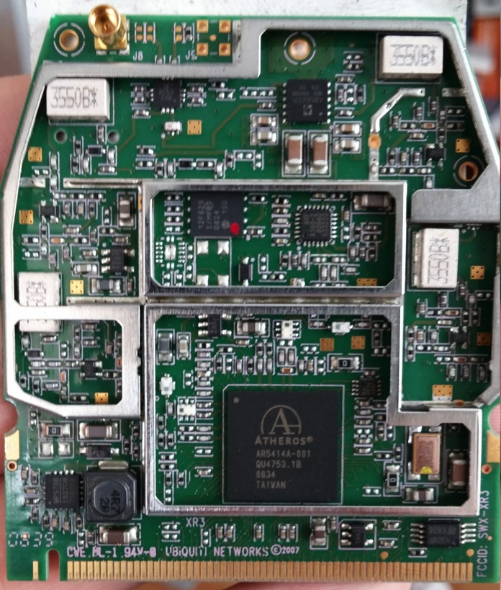
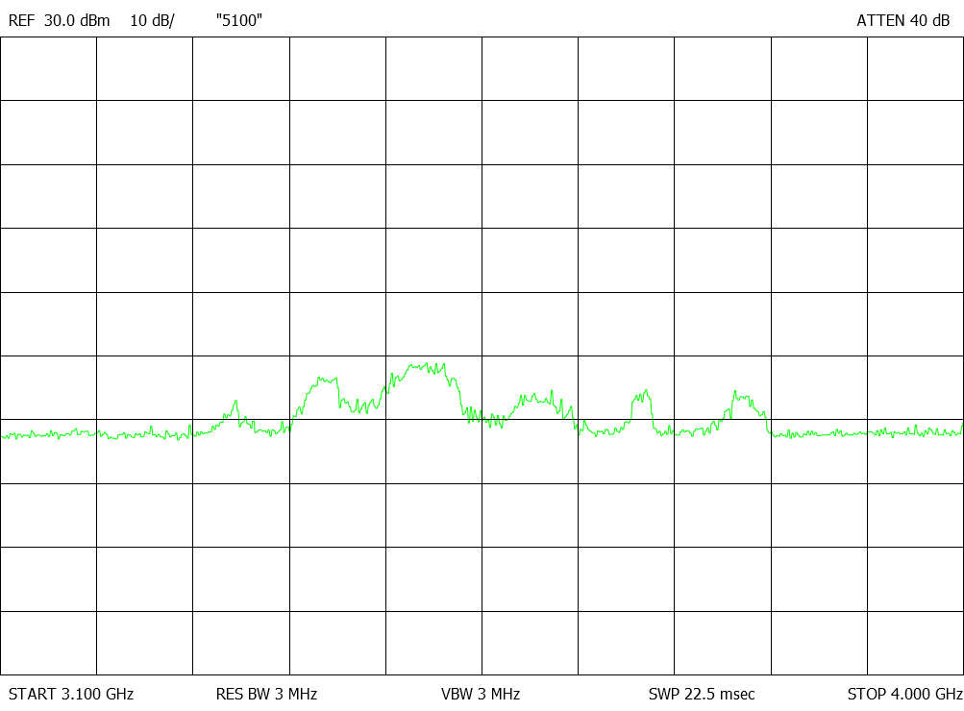
UBNT XR3 9CM CARDS – MIKROTIK ROUTER HOST

Slide 39
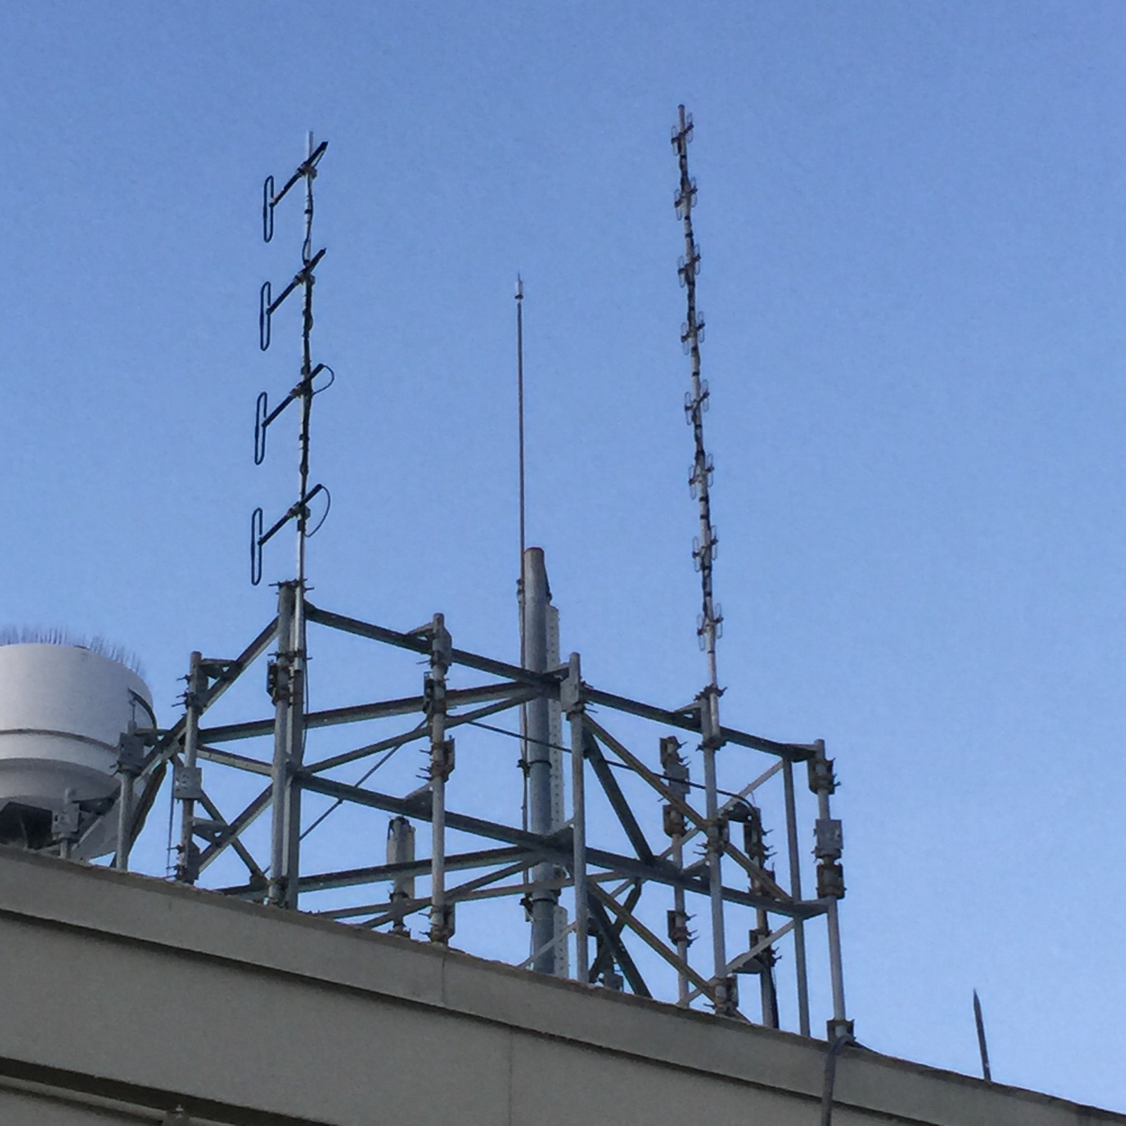
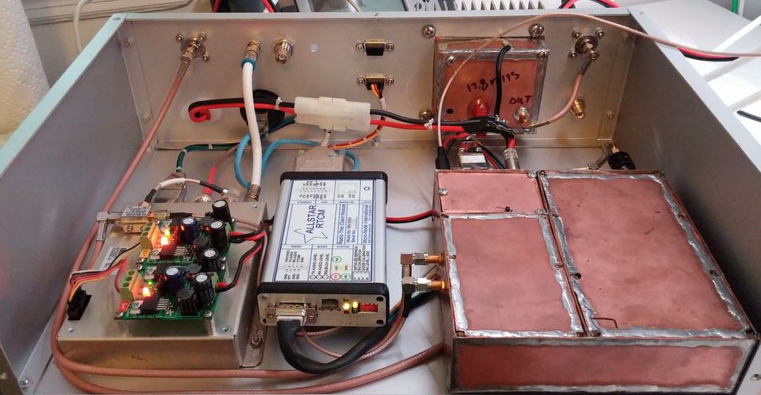
224.28 W9CR REPEATER ALLSTAR IP RTCM INTERFACE

Slide 40
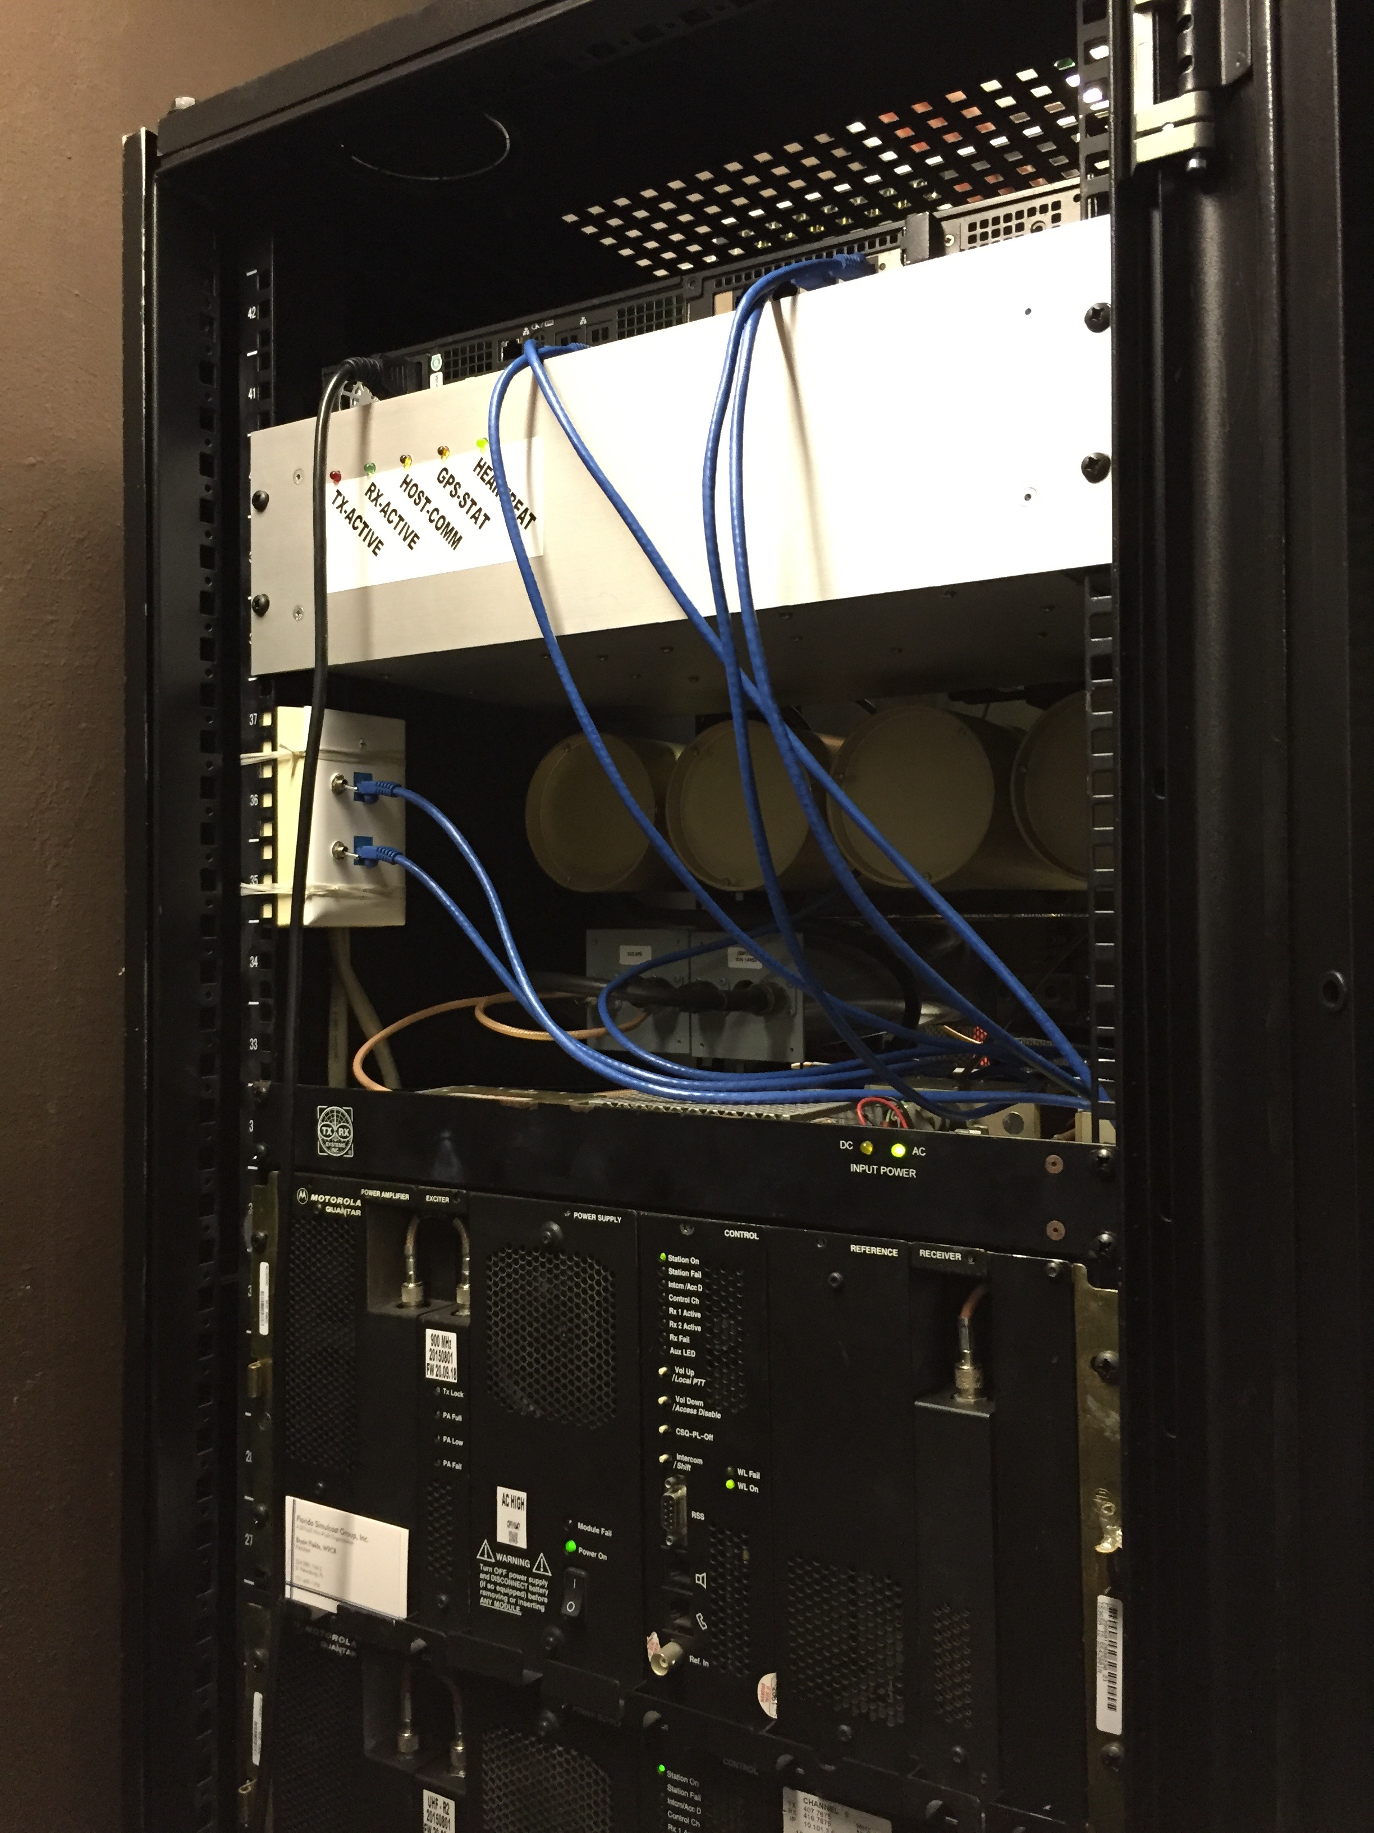
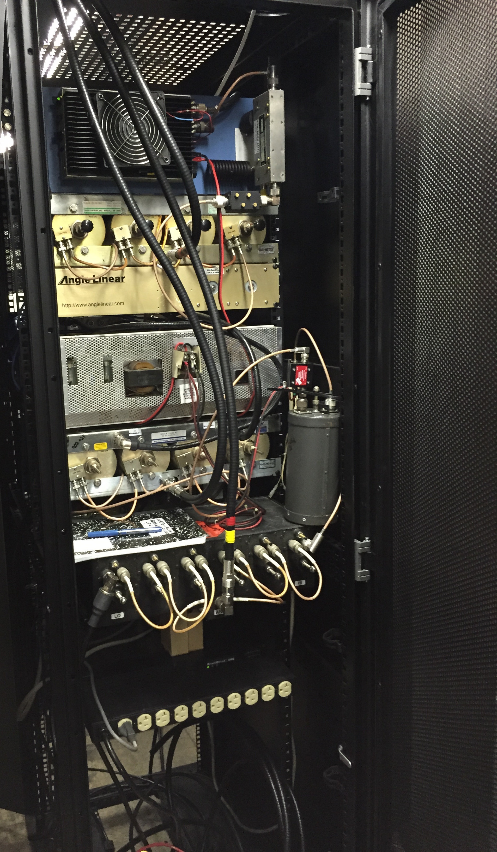
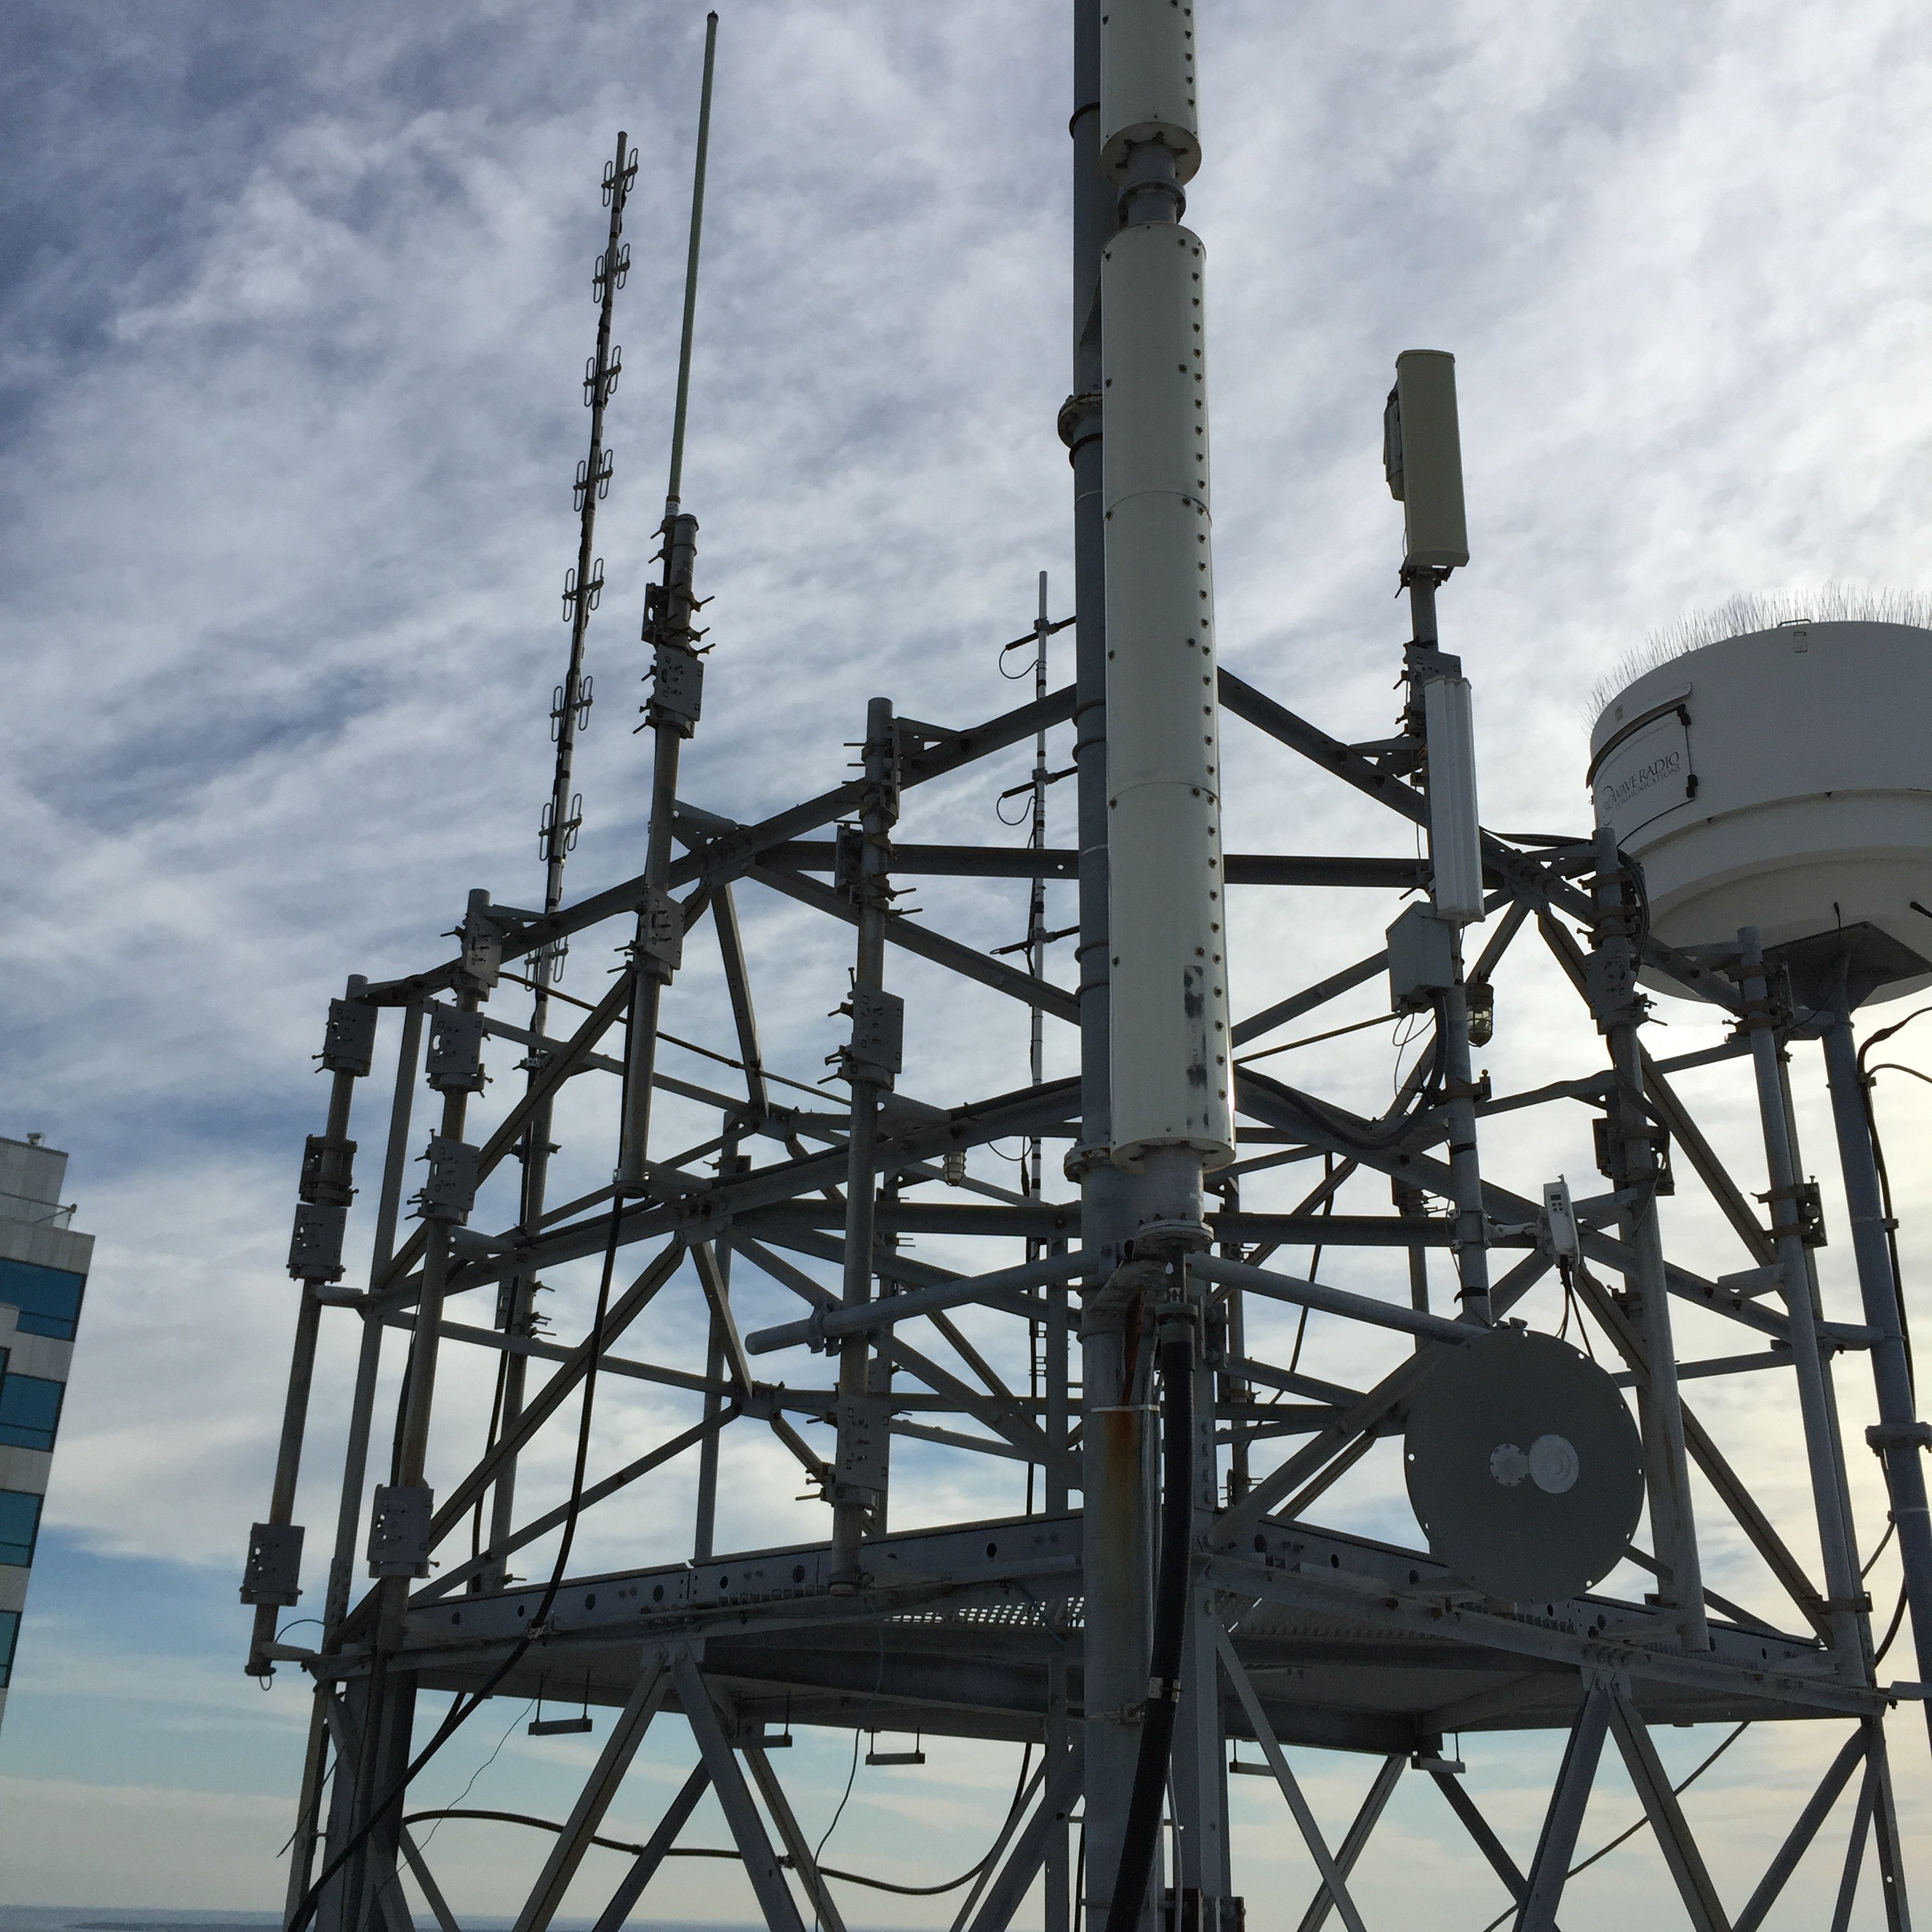
TAMPA SITE SECTORS AT 500’

Slide 41
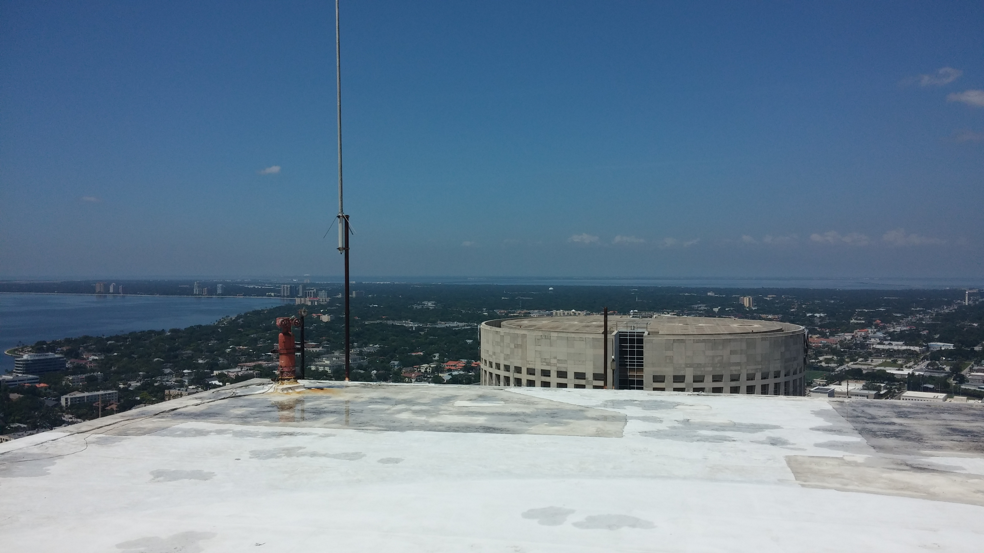

Slide 42
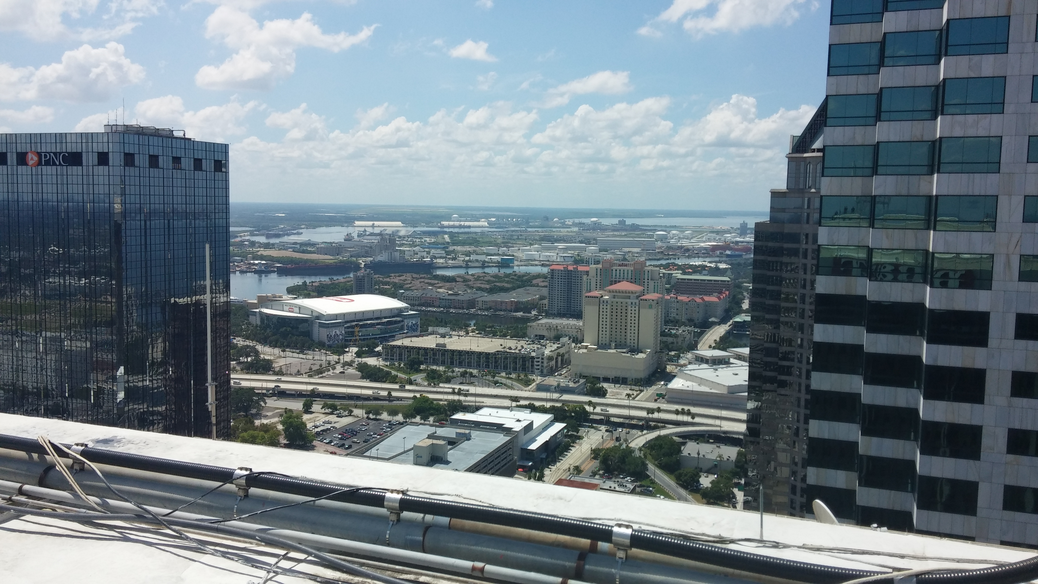

Slide 45
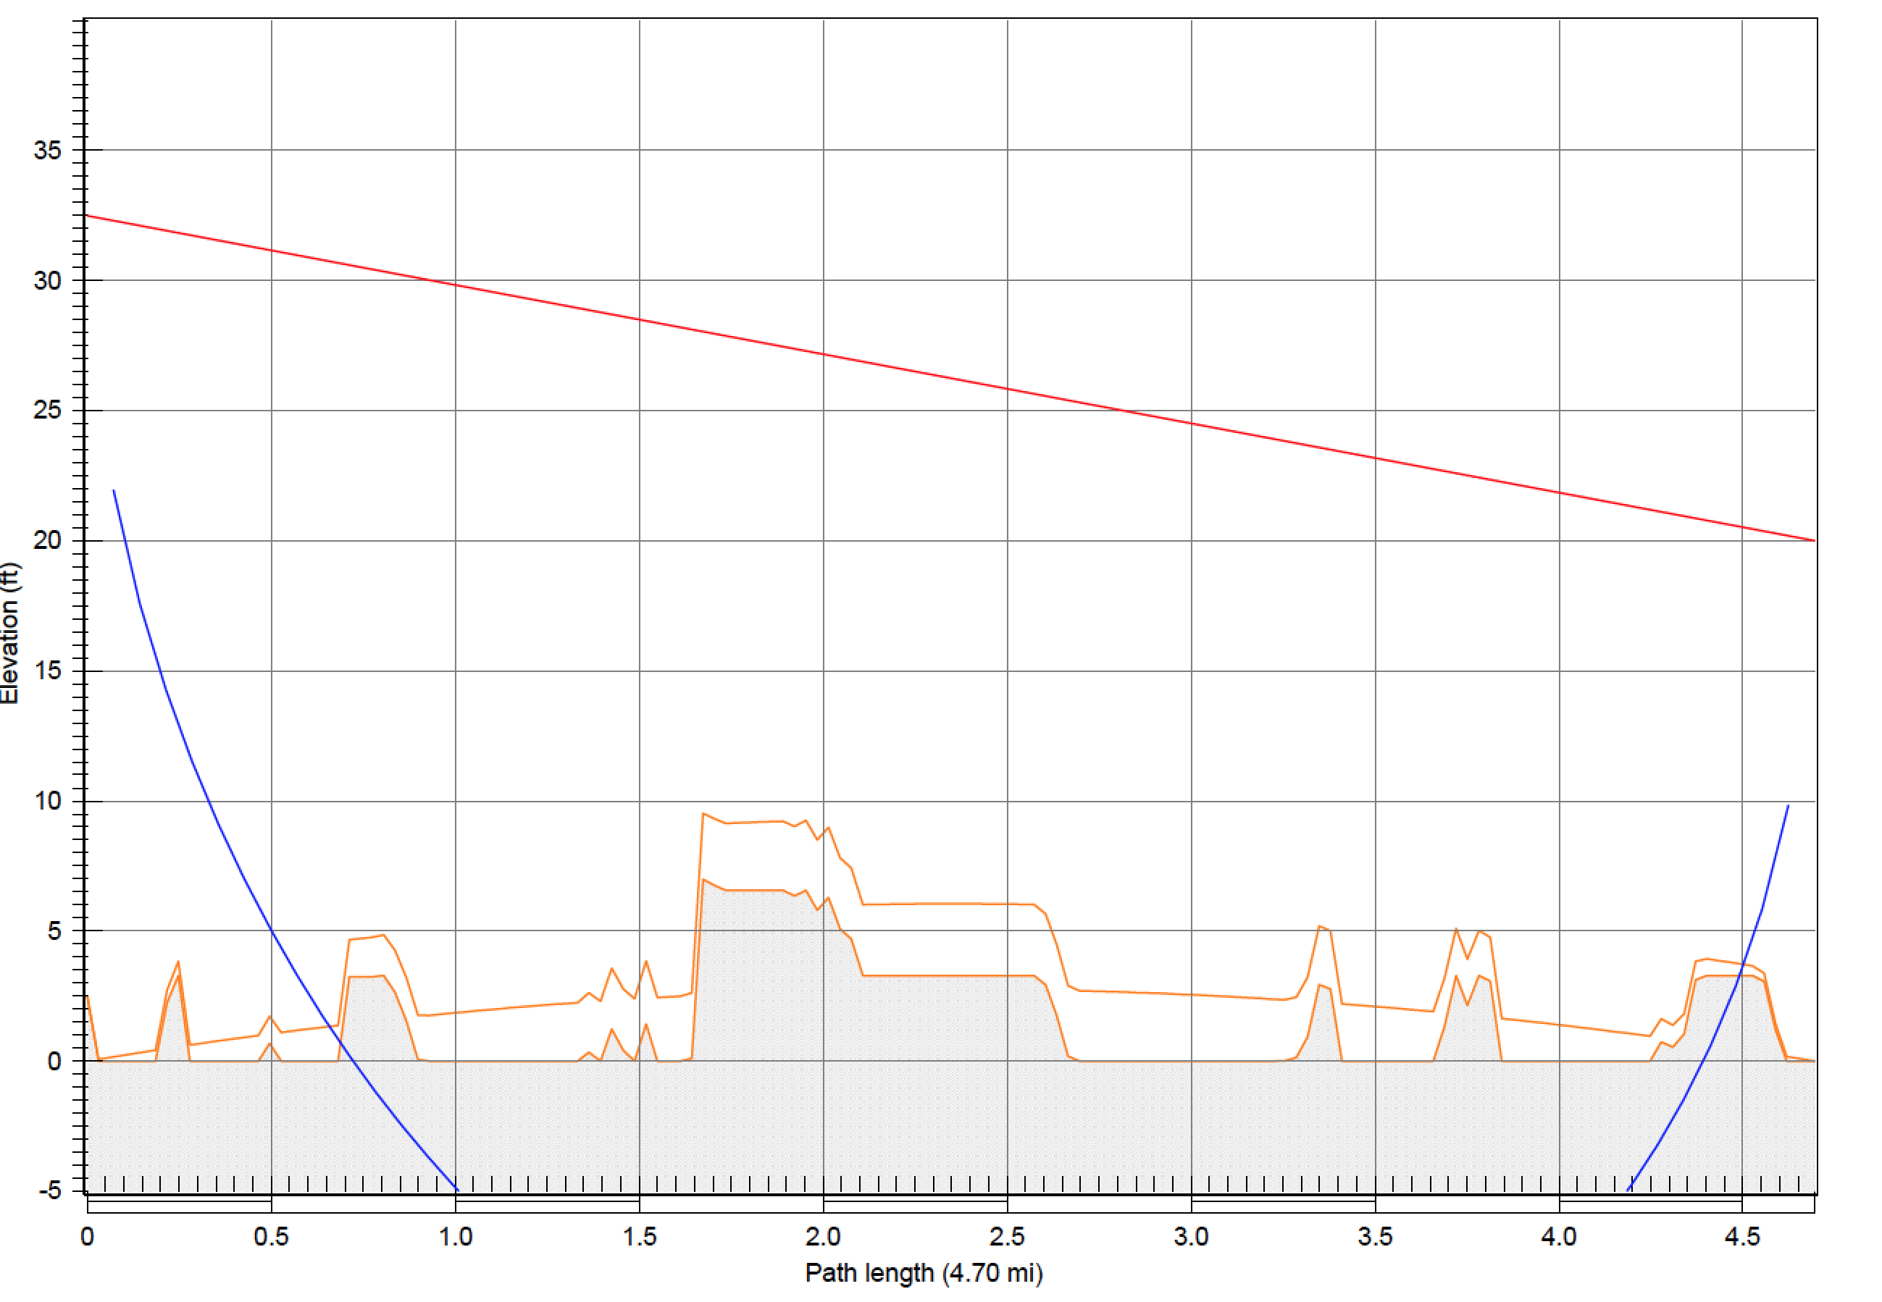
PATHLOSS 5.0 PROFILE

Slide 46
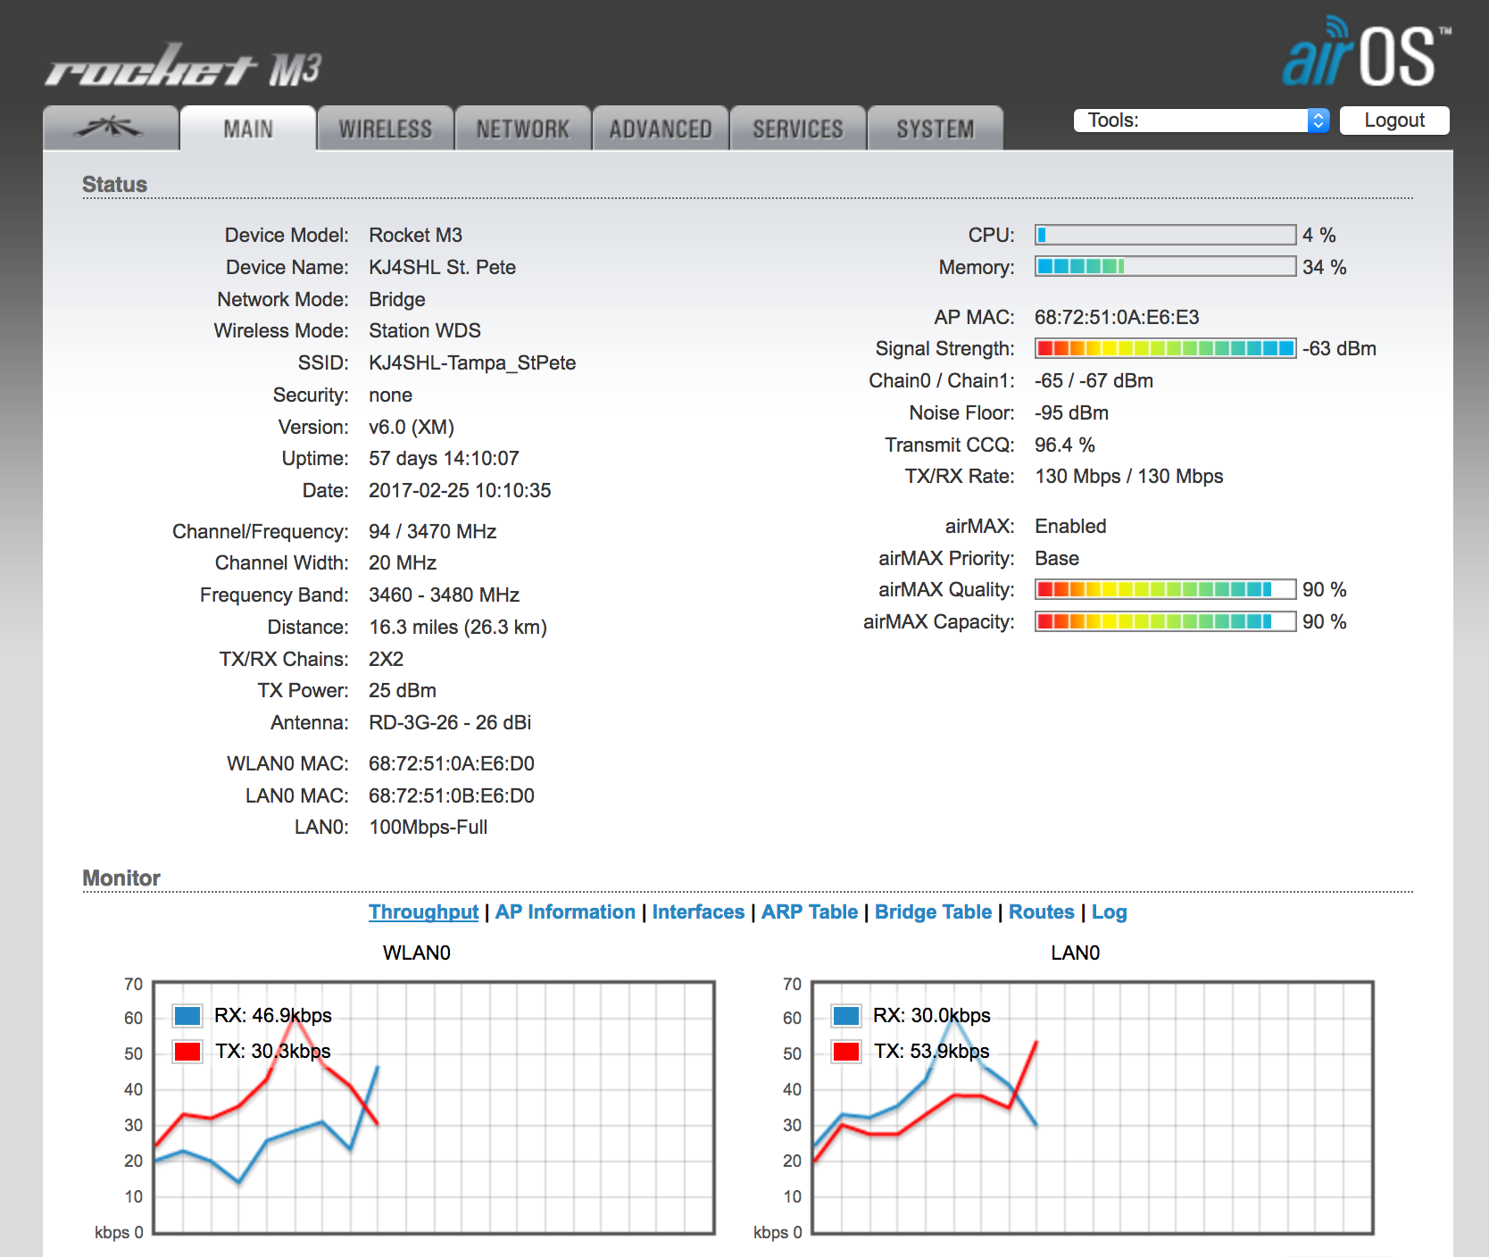
ST PETE

Slide 47
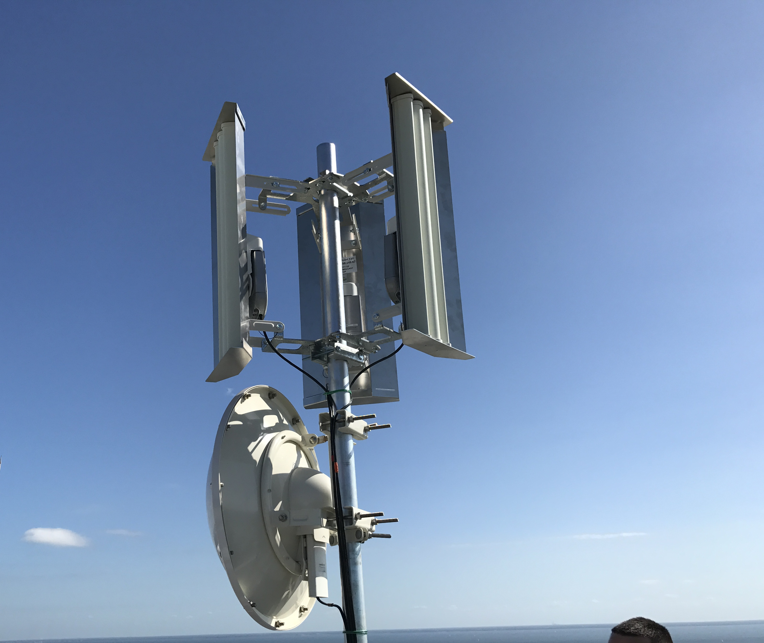
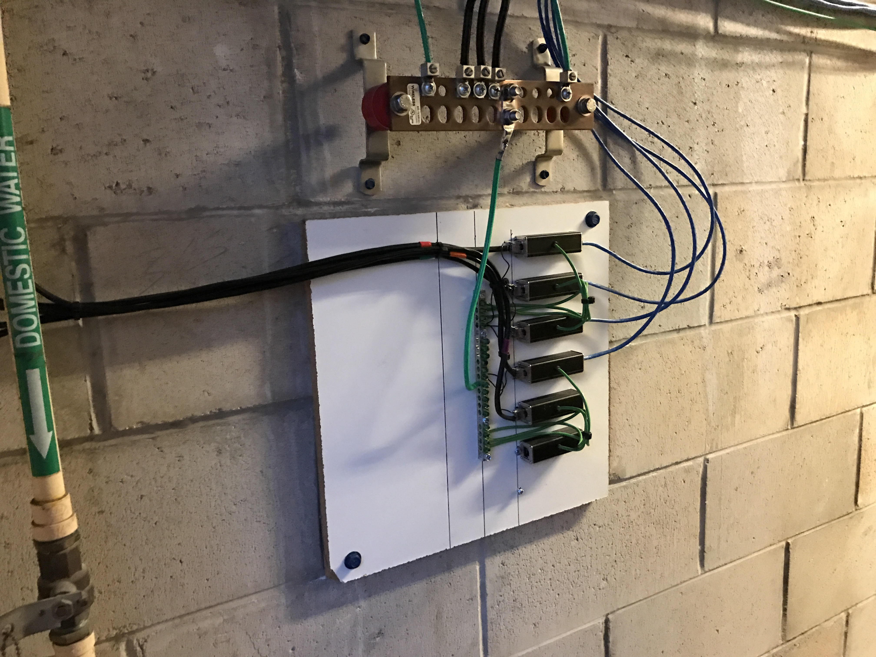
ST PETE

Slide 48
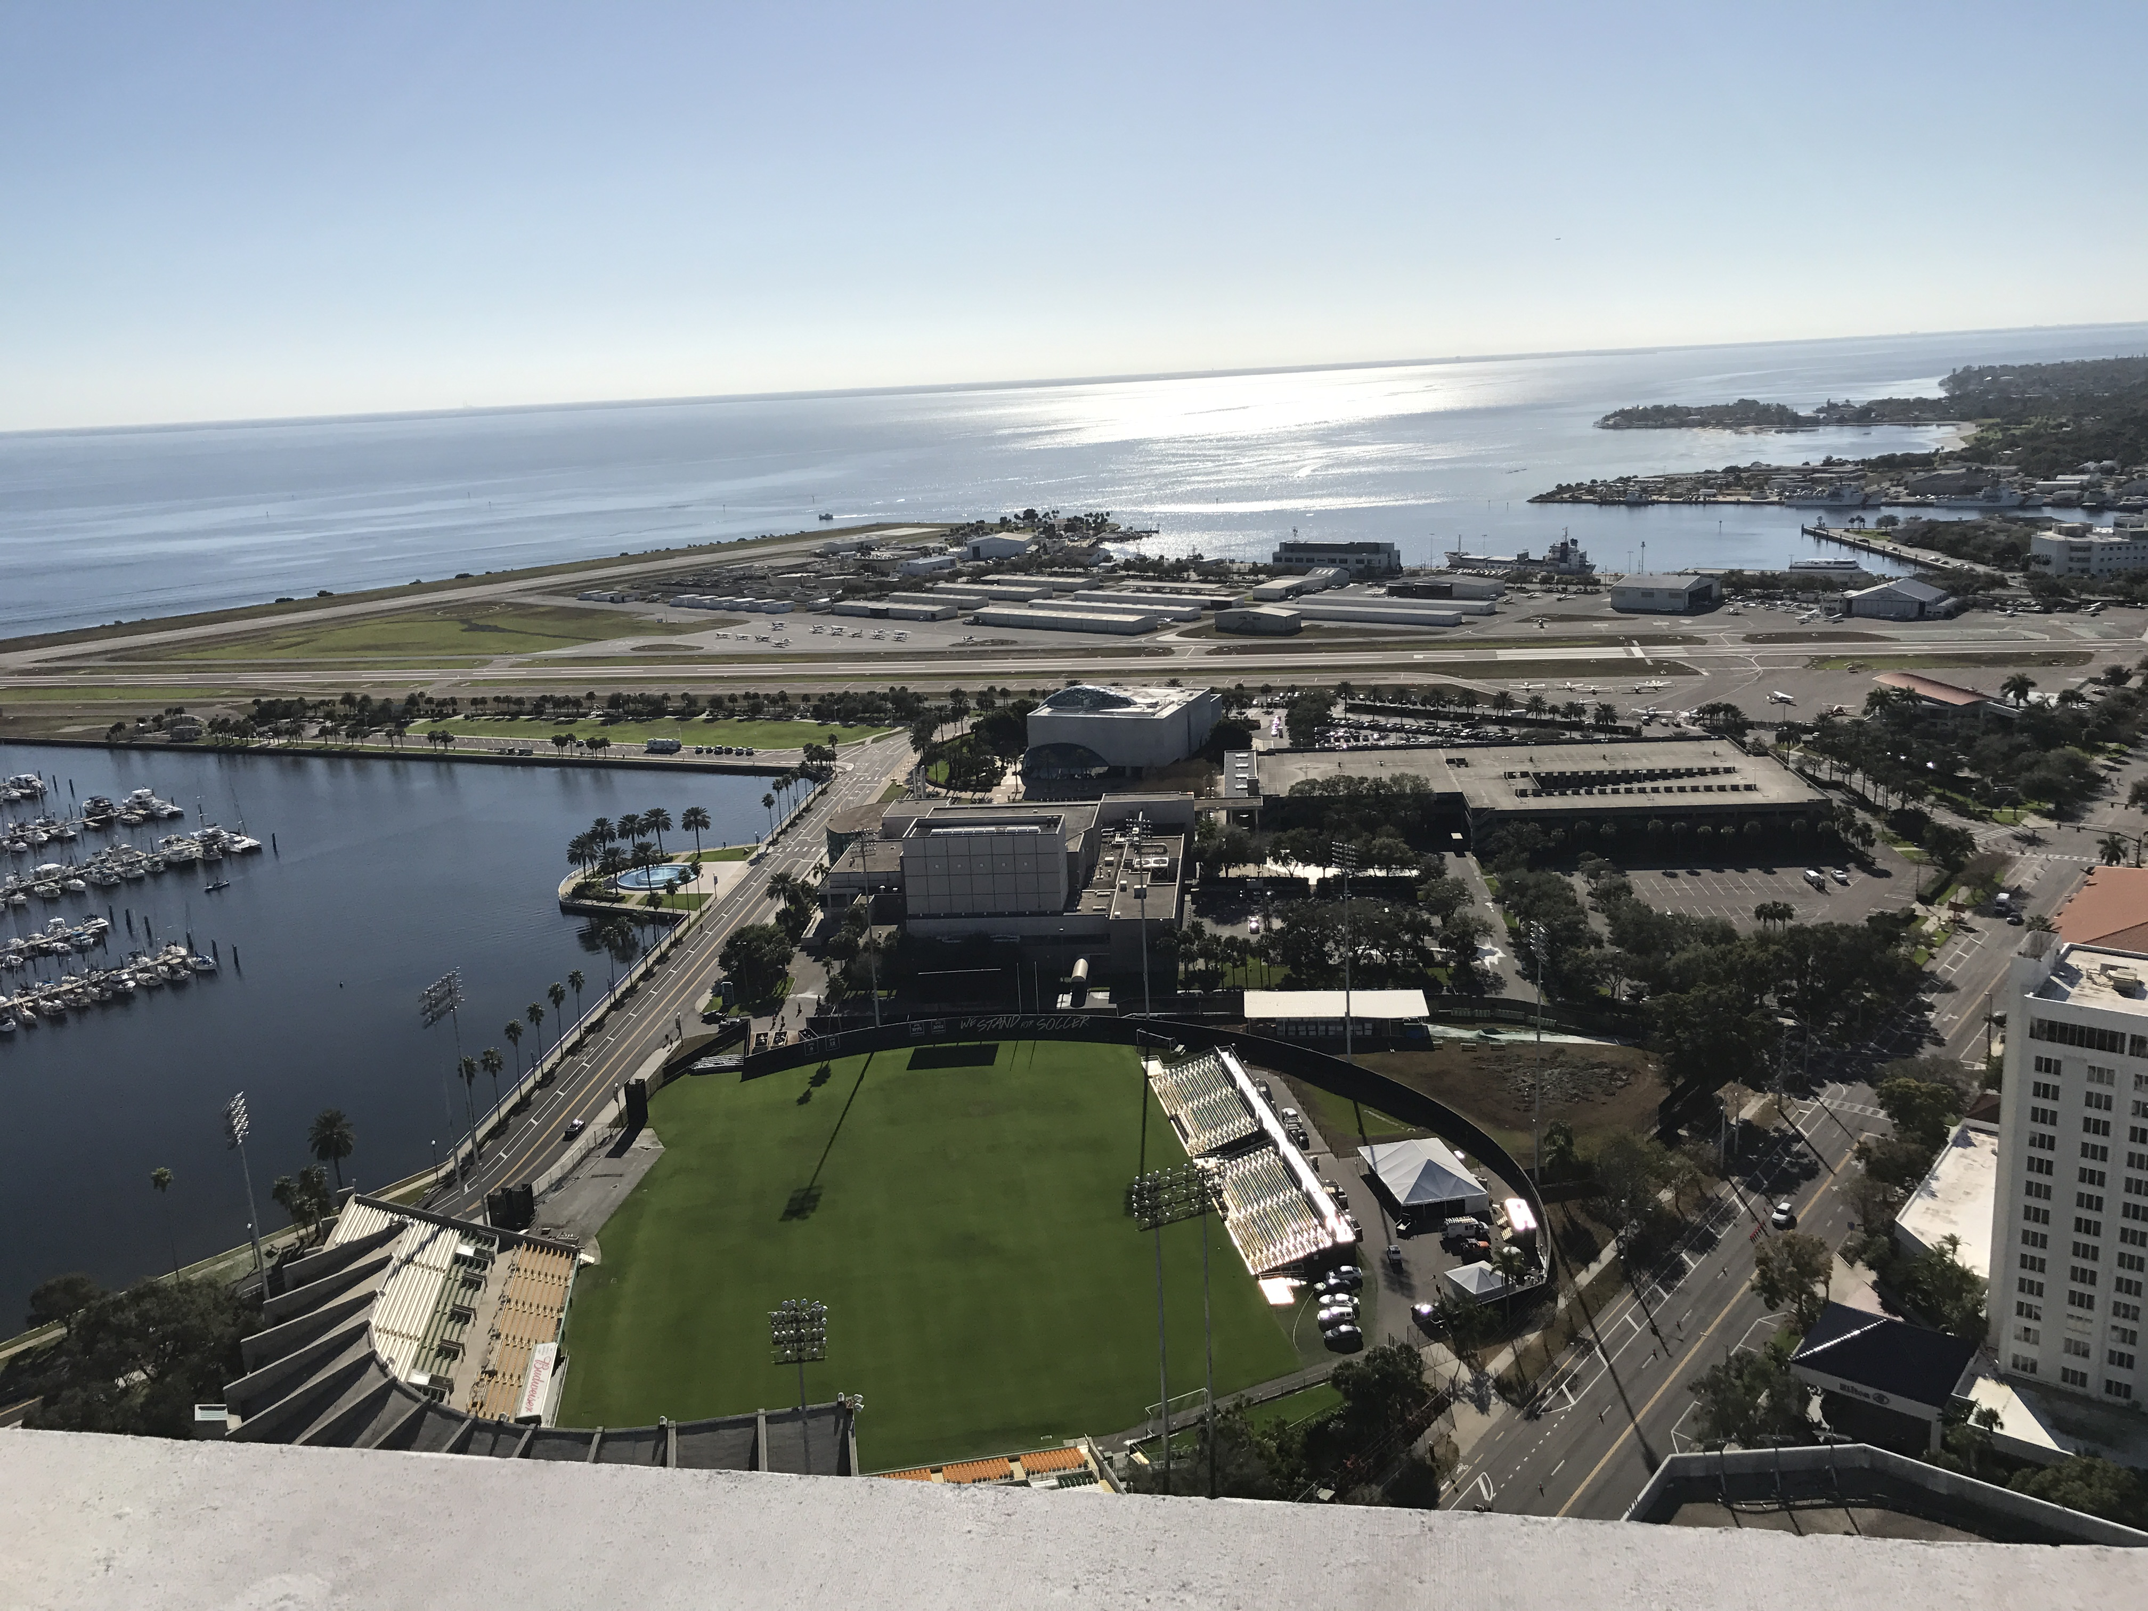
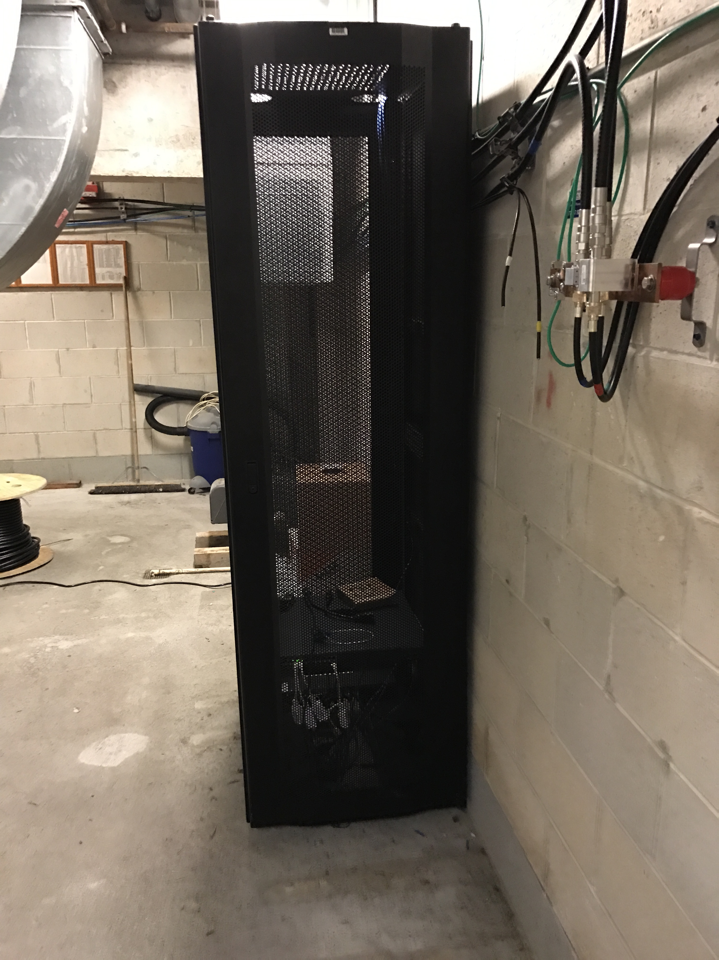
ST PETE

